Slide 1
Leveraging Community and Cultural Strengths to Achieve Health Equity for Pasifika: Lessons from Ho‘ouna Pono Implementation Studies
Kelsie H. Okamura, PhD
Implementation Researcher | Lecturer of Psychology
January 23, 2024

Slide 2
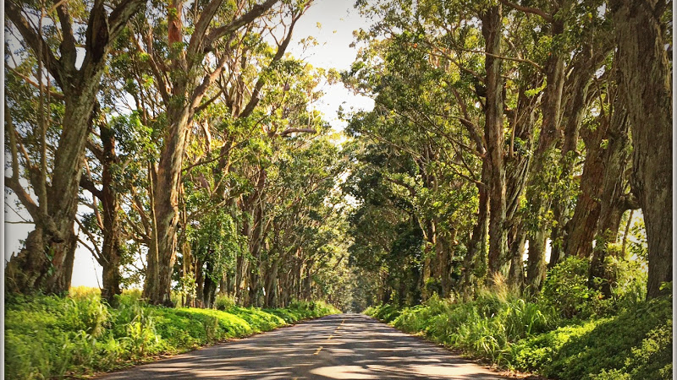
Where we are headed:
The public health and scientific problem
Why implementation science?
What’s next?
Notes:
Describe what I do
Use terminology in the work that you do
Some science-based
Use some of that in the work I do
Half cooked projects
History of CAMHD and the work we’re doing
Big take home points
Consider practice

Slide 3
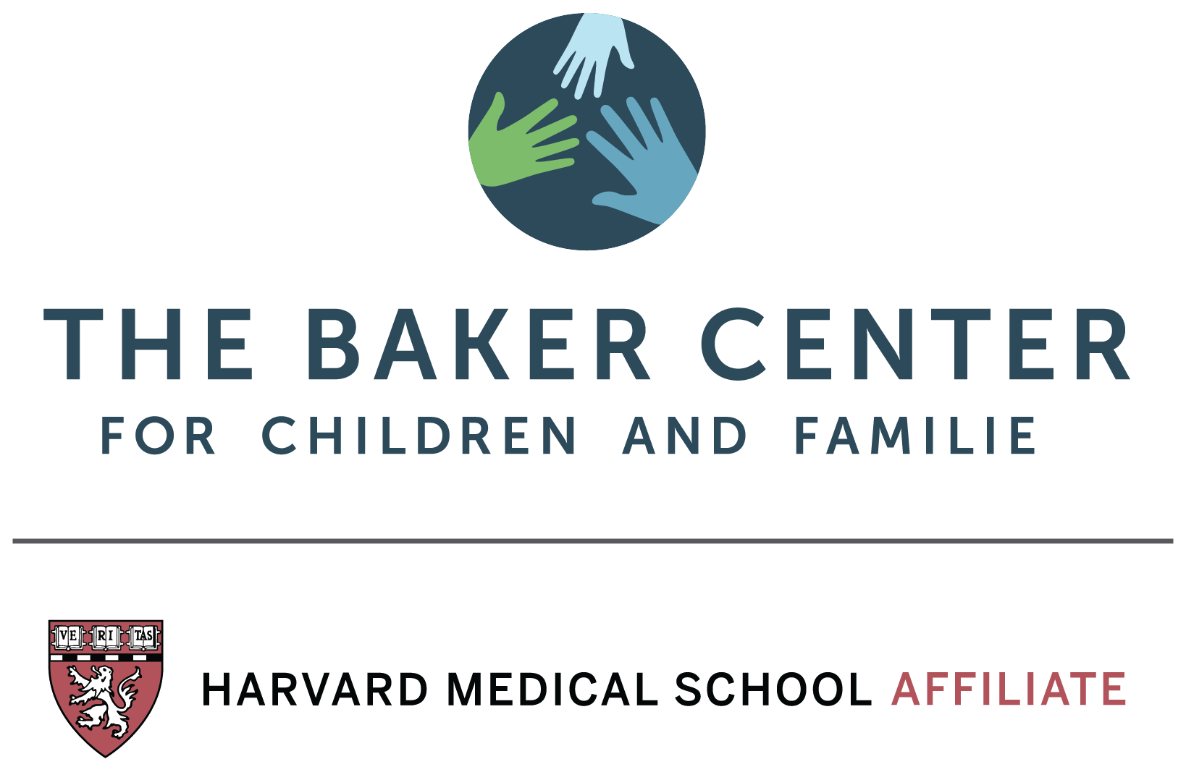
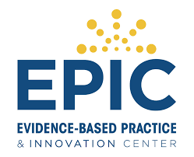
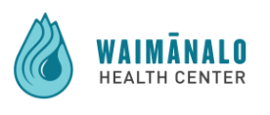
A little about me…
RESEARCH
Implementation science
Marginalized populations
CLINICAL
Youth modular approaches
Psychoeducational testing
Integrated behavioral health
Rural mental health
Disclosure: I am a paid consultant for

Slide 4
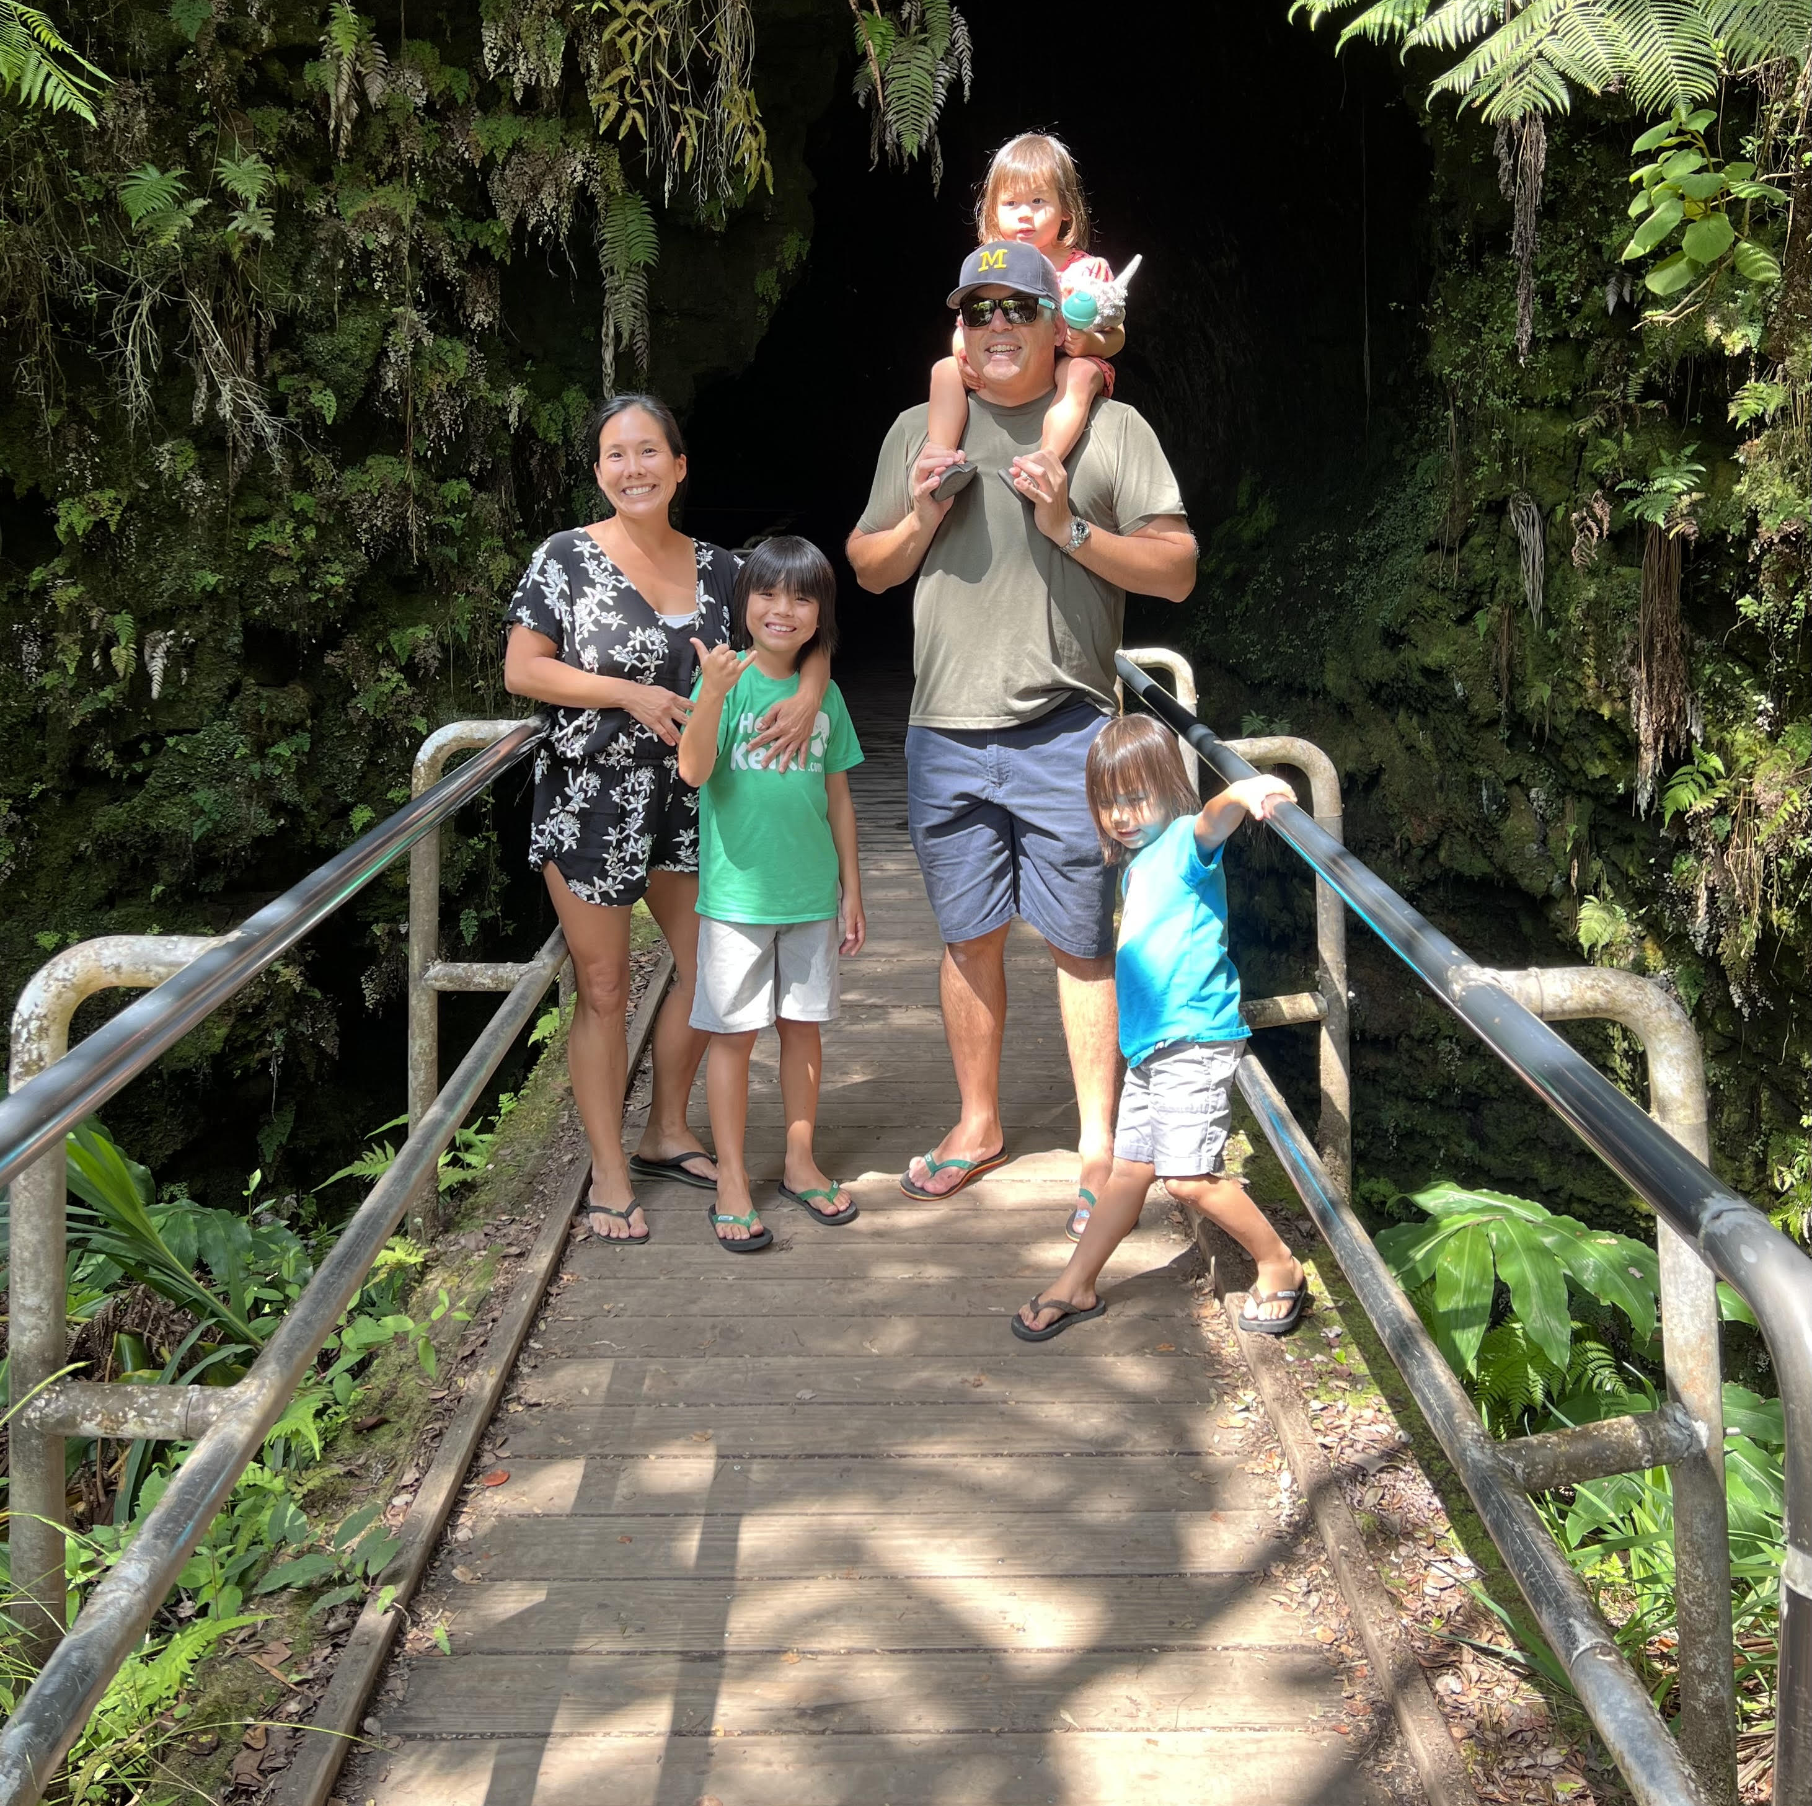
Who am I?
Mother of 3
4th generation Okinawan Japanese
Waipahu, Oʻahu
Psychologist
Implementation researcher
Soccer player
Notes:
mentorship and professional lineage are hugely important to you and that's something that you do in your work and hope to provide to students in their program. This is the kind of mentorship and support that doesn't just leave you at the end of class or graduation, it's a part of building a career, a network within the field. Of course, perhaps this is not the time to say that, but I do think it's a part of what I imagine makes you a good mentee (thus your continued work with and gratitude toward Brad), and I know it's a part of what makes you a good mentor/professor/advisor/supervisor...etc., etc.

Slide 5
Imagine a world…
Notes:
Let’s start with some quick guided imagery to ground us in the work we are all doing. I want you to imagine a world where there is no suffering. The problems you face have quick and efficient solutions. There are no disparities on who receives these solutions and they are all uniquely tailored to individual needs.
What are you doing in this world? Where are you? What is your family doing?
I want you to keep this world in mind as I talk about some of the work that I have been a part of over the years to create our idea of this world…and the exciting road ahead.

Slide 6
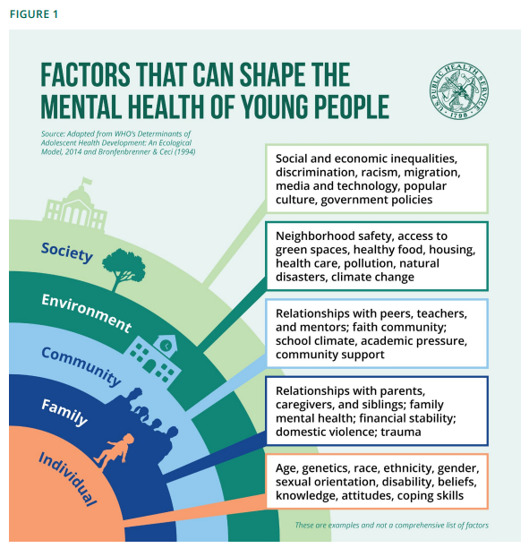
Public health problem
1 in 5 youth will suffer from a mental health concern by age 18
COVID-19 and other societal pressures have heightened mental health need
Receive none or little care that is not informed by evidence
Research to practice gap
Merikangas et al., 2010; Office of the Surgeon General, 2022
Notes:
Receive no care
Little care not informed by evidence
Mention surgeon general’s call for youth mental health treatment across systems

Slide 7
Notes:
We are working on two sides simultaneously to help youth receive evidence-based practice

Slide 8
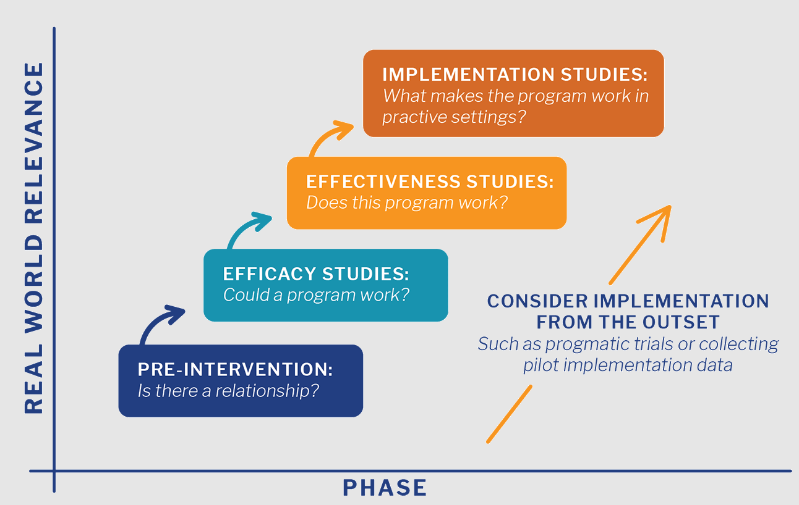
Research to Practice Gap
Green, 2008; Harvard Catalyst, 2024
Notes:
Implementation science allows for systematic study of strategies and mediators in EBP uptake and utilization

Slide 9
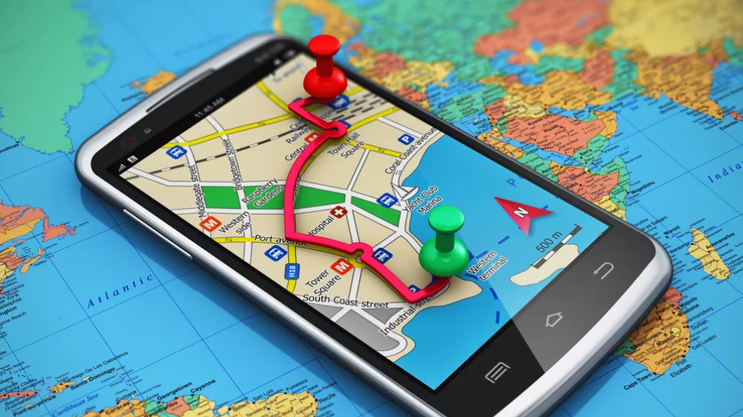
The SCIENTIFIC problem
There is an over saturation of information

Slide 10
Applying implementation science to Ho'ouna Pono sustainability for Native Hawaiian youth in rural Hawai'i
This research was funded by the National Institute on Drug Abuse (R34 DA046735; L60 DA059132), with supplemental funding from the Center for Pacific Innovations, Knowledge, and Opportunities (NIGMS, U54GM138062)
Notes:
Culturally grounded
Modular, interactive, video-enhanced
Teacher-implemented
Developed through four NIDA-funded projects

Slide 11
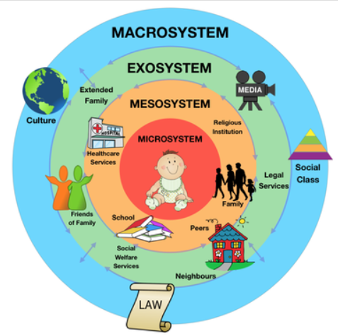
The context
Native Hawaiian and Pacific Islander have significantly higher rates of drug use
More disparate in rural settings
Socioecological influence on substance use

Slide 12
Yet…
Research has indicated haphazard or poorly planned implementation of drug prevention programs in Hawaiʻi
Hawai‘i Island educational partners have pointed to systemic issues related to the implementation, adoption, and sustainability of prevention in schools
Need for research focused on measurement in implementation science

Slide 15
Multimethod Implementation Research Approach
Formative, mixed-methods studies with Hawaiʻi island educational collaborators and partners
In-depth individual interviews (N = 24)
Implementation, adoption, and sustainability surveys (N = 204)
Concept mapping (N = 7)

Slide 16
Participants
 | In-Depth Interviews (N = 24) | Surveys (N = 204) | Concept Mapping (N = 7)
Gender (Female) | 50% | 71% | 62.5%
Ethnicity
Hawaiian/Part-Hawaiian | 21% | 32% | 16.7%
Japanese | 8% | 28% | 16.7%
Korean | -- | -- | 8.3%
Other Pacific Islander | -- | -- | 8.3%
Portuguese | -- | -- | 16.7%
White | 46% | 55% | 25%
HIDOE Role
School Counselor/SBBH | 21% | 15% | 14.3%
Superintendent/ Principal/VP | 33% | 10% | 14.3%
Teacher | 38% | 56% | 0%
District Education Specialist | -- | -- | 28.6%
State Education Specialist | -- | -- | 42.9%
Other | 8% | 20% | 0%
Education
Undergraduate Degree | 21% | 36% | 25%
Graduate Degree | 79% | 55% | 75%

Slide 17
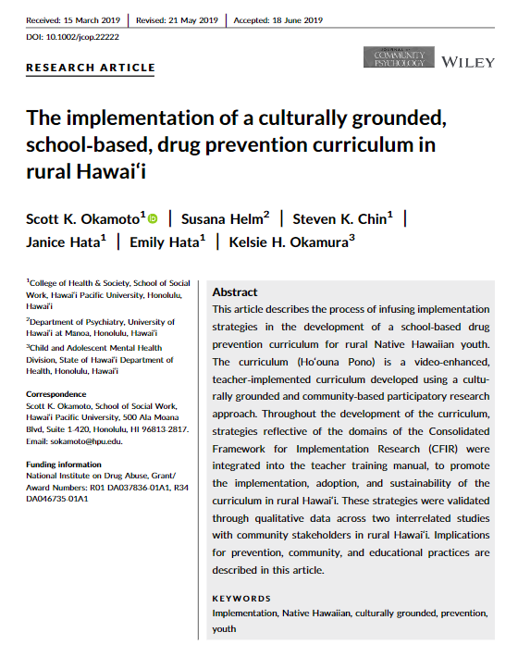
STUDY 1

Slide 18
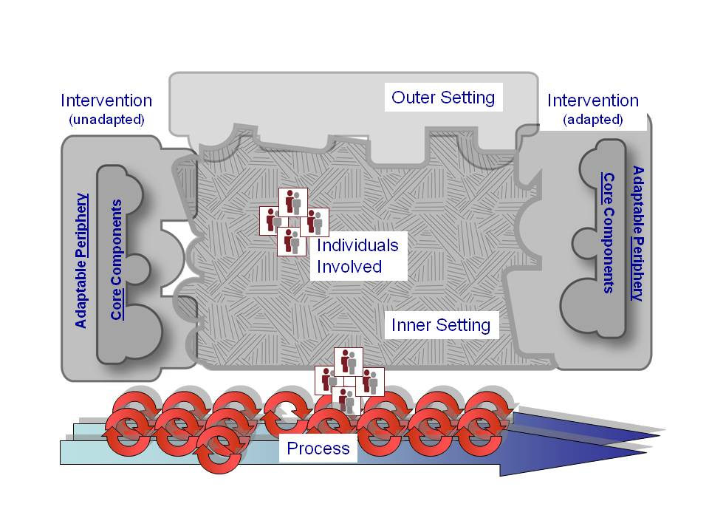

Slide 19
Semi-Structured Interview
Question | CFIR Domain/ Construct(s)
What can be done to further promote Ho‘ouna Pono’s alignment with teachers’ professional and educational needs? | Innovation/ Innovation Adaptability
How do local, state, or national performance measures or policies influence the implementation of Ho‘ouna Pono? | Outer Setting/ Policies & Laws
Which teacher(s) should oversee the implementation of the curriculum in your school ? Why? | Inner Setting/ Work Infrastructure
How confident do you feel about implementing Ho‘ouna Pono in your classes? | Individuals/ Innovation Deliverers, Capability
Who do you see as the lead person implementing the curriculum in your school? | Process/ Teaming

Slide 20
Local culture reflection
“I thought that they were very [good]. I was very impressed at the level of the kids’ ability to come across genuine [in the videos] and of course the way in which Matt [the director] put the [videos] together. The way they were scripted was very genuine. And the [youth actors] did a great job and that, of course, will bite right into the other kids as they watch it, because you can really feel the emotion when you’re looking at ‘em. And I loved the cross section of where the vignettes occurred. I mean, awesome, awesome, awesome. I mean, a lot of the time people don’t want to talk about what’s happening at the house and the party on the weekend. And so I thought the videos were excellent.”

Slide 21
Implementation Survey
STUDY 2
Notes:
50 items reflecting barriers to implementation of Ho‘ouna Pono in Hawai’i Island public middle/intermediate schools
Participants evaluated each item on two dimensions
The magnitude (impact) of each barrier on the IAS of Ho‘ouna Pono in Hawai’i Island schools
The difficulty in overcoming each barrier to the IAS of Ho‘ouna Pono in Hawai’i Island schools

Slide 22
Highest impact barriers
Rank | Item | Mean (SD) | CFIR 2.0 Domain/Construct(s)
1 | The HP curriculum does not extensively cover current or recent forms of substance use, such as vaping. | 3.30 (1.00) | Innovation/ Innovation Adaptability
2 | Some HIDOE teachers are resistant to trying new curricula like HP, because it feels like "one more thing you [administrators] want me to do in the classroom." | 3.27 (1.04) | Individuals/ Innovation Deliverers, Motivation
3 | There is a lack of HIDOE funding to support prevention curricula like HP. | 3.26 (1.09) | Outer Setting (HIDOE)/ Financing
4 | The implementation and training related to the HP curriculum will be difficult to fit into teachers' busy schedules. | 3.14 (1.03) | Inner Setting (HIDOE)/ Structural Characteristics, Work Infrastructure
5 | The delivery of the HP curriculum is assigned to a teacher who is resistant to using the curriculum. | 3.09 (1.20) | Individuals/ Innovation Deliverers, Motivation

Slide 23
Most difficult barriers
Rank | Item | Mean (SD) | CFIR2.0 Domain/Construct(s)
1 | Some HIDOE teachers are resistant to trying new curricula like HP, because it feels like "one more thing you [admin] want me to do in the classroom." | 3.56 (1.00) | Individuals/ Innovation Deliverers, Motivation
2 | The implementation and training related to the HP curriculum will be difficult to fit into teachers' busy schedules. | 3.32 (1.02) | Inner Setting (HIDOE)/ Structural Characteristics, Work Infrastructure
3 | There is a lack of HIDOE funding to support prevention curricula like HP. | 3.30 (1.02) | Outer Setting (HIDOE)/ Financing
4 | The HP curriculum would require additional work for teachers in immersion schools who need to translate the lessons into Hawaiian. | 3.30 (1.04) | Individuals/ Innovation Deliverers, Capability
5 | The delivery of the HP curriculum is assigned to a teacher who is resistant to using the curriculum. | 3.30 (1.07) | Individuals/ Innovation Deliverers, Motivation
Notes:
Take home points:
Financial resources are a major consideration in the implementation of prevention
Barrier: Lack of funding
Facilitator: No cost for curriculum
Role conflicts between administrators and teachers present an implementation barrier
Intervention characteristics as an implementation facilitator
Share these findings with HIDOE leadership and create cross level implementation strategies

Slide 24
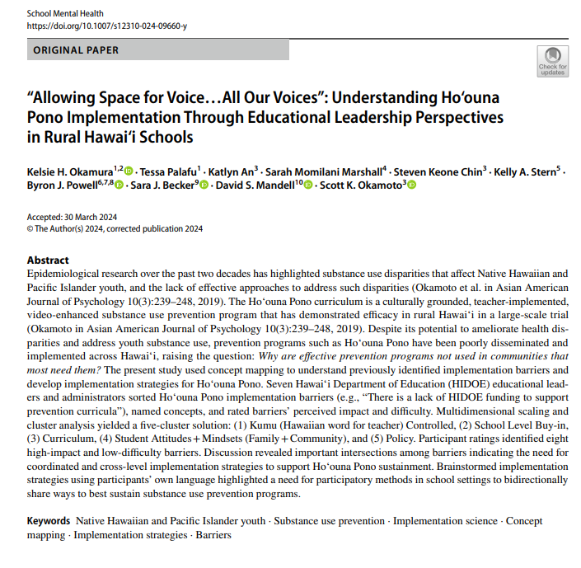
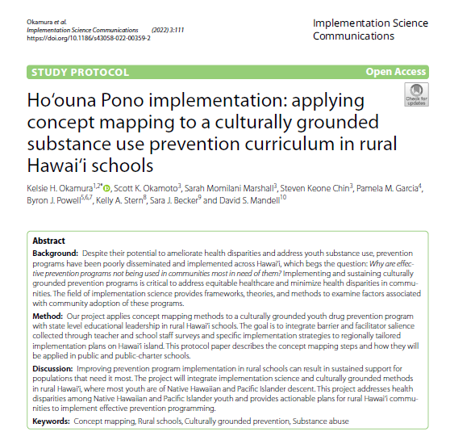
STUDY 3

Slide 25
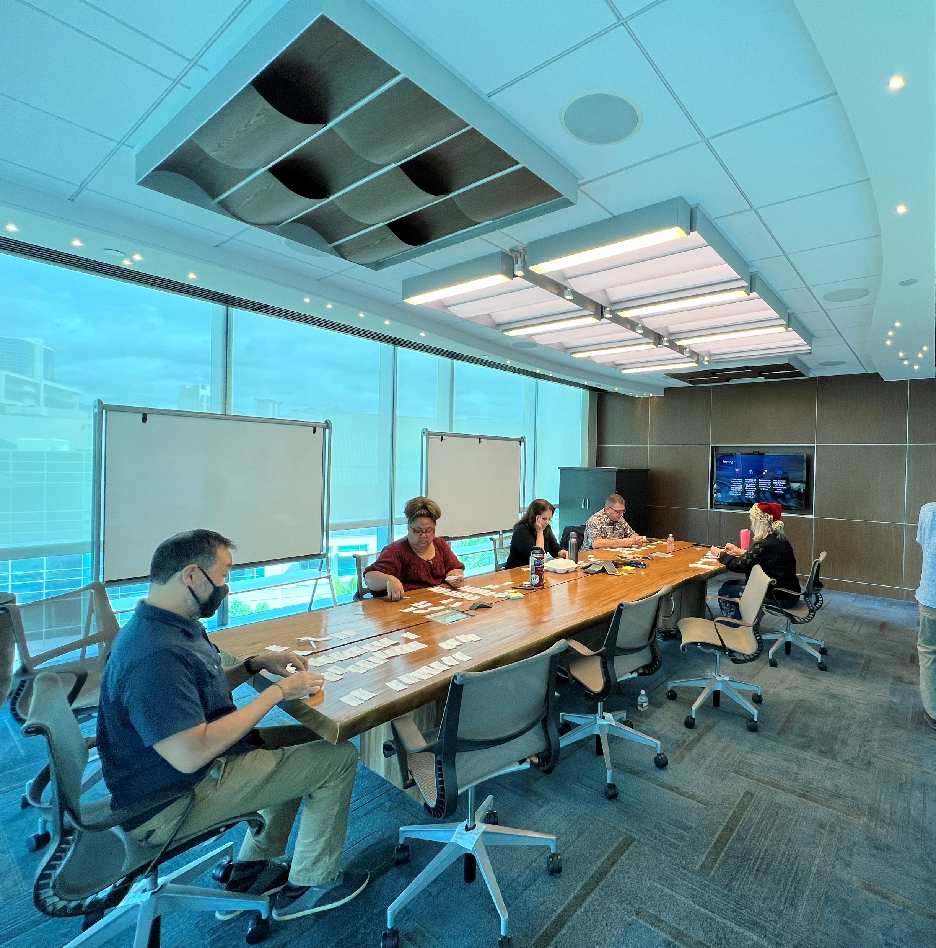
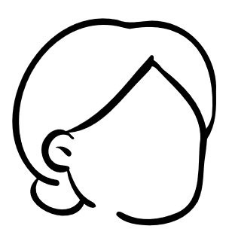
Preparation
Idea generation
Organization
Visual representation
Interpretation
Utilization

Slide 26
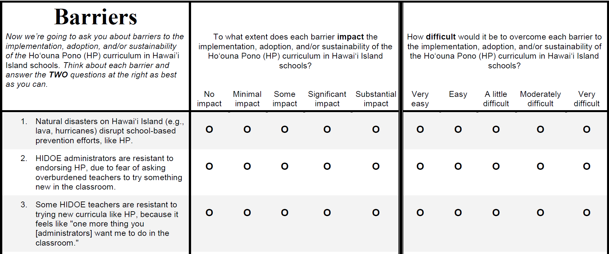
Preparation
Idea generation
Organization
Visual representation
Interpretation
Utilization
Okamoto et al., 2020
Notes:
50 items reflecting barriers to implementation of Ho‘ouna Pono in Hawai’i Island public middle/intermediate schools were provided to participants and they were instructed to sort these barriers into meaningful categories. These barriers were initially identified by Hawai’i Island school staff including teachers, counselors, and administrators.
Participants then rated each item on two dimensions
The magnitude (impact) of each barrier
The difficulty in overcoming each barrier
After the first meeting, multidimensional scaling and cluster analysis was completed by the research team to examine the similarities across individual participants’ sortings and to layer the impact and difficulty ratings. These produced two reports including the Concept Map and the Go Zone.

Slide 27
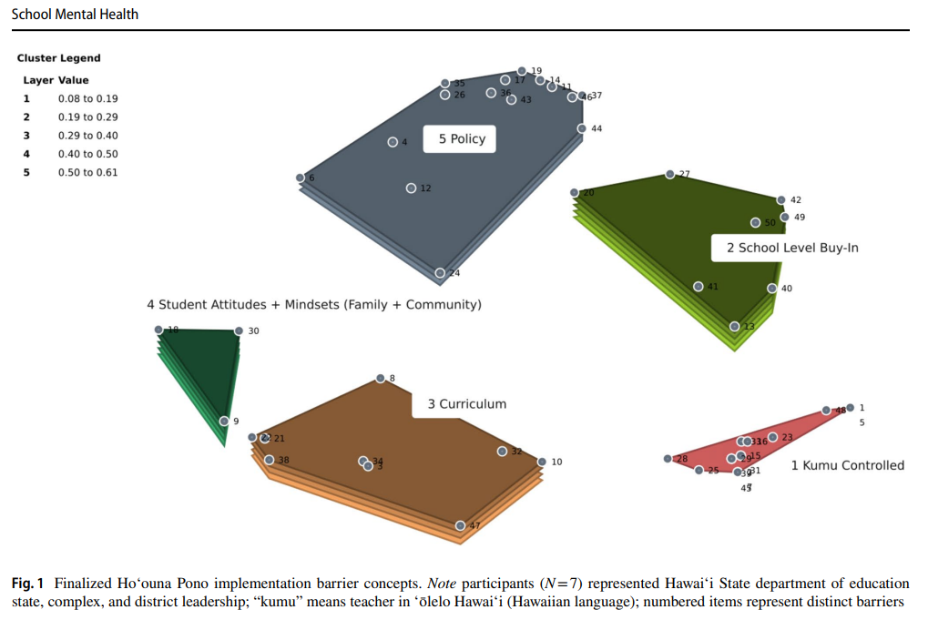
Preparation
Idea generation
Organization
Visual representation
Interpretation
Utilization
Concept Map
Okamura et al., 2024
Notes:
Multidimensional scaling produced a point map that revealed the extent to which each barrier was commonly group with other barriers. So as you can see on this concept map, each individual dot represents a barrier (37: The HIDOE does not specify the structure or content of substance use prevention in schools). Cluster analysis revealed concept maps with four to 14 clusters and the research team reviewed the four-, five-, and six-cluster solution items for cohesive themes as identified by each label, and bridging values, ranging from 0 to 1 with lower values indicated anchoring statements and higher values that “bridge” or were commonly grouped together. These bridging values aggregate to the layer value noted above such that concepts with higher layers have more items with higher bridge values. Looking at this concept map, we see that many barriers related to Kumu controlled (Kumu is the Hawaiian word for teacher) were commonly grouped together and not with other barriers within other concepts on the map. On the contrary, the School level Buy-In, Curriculum, and Student Attitudes + Mindsets (Family + Community), have higher layer values indicating that the barriers comprised of these concepts were commonly grouped with other barriers and concepts.
In the first part of the phase two discussion, participants were asked to review the items within each cluster to look for similarities and any outliers that needed to be moved. Then, cluster names were reviewed and edited within the group. Discussion changed one cluster name from “School-Level” to “School-Level Buy-In.” Additionally, three items were moved from the “Student Attitudes + Mindsets (Family + Community)” to “Curriculum.”
The Ho‘ouna Pono curriculum does not extensively cover current or recent forms of substance use, such as vaping
After 10 years, the Ho‘ouna Pono curriculum may need updating, by changing youths’ language and jargon depicted in the videos
The Ho‘ouna Pono curriculum lacks a social media presence (e.g., Twitter, Instagram, Facebook)
Bridging values allow us to identify anchor and bridge statements​
Anchoring values range from 0 to 1 (bridging value reference) – lower values are anchors and are typically located within a cluster of topics, higher values are bridges that suggest a higher relationship across various statements on the map

Slide 28
Preparation
Idea generation
Organization
Visual representation
Interpretation
Utilization
High
Low
Go Zone
Low
High
Okamura et al., 2024
Notes:
Additionally, the Go Zone report was created to create quadrants of participants’ impact and difficulty ratings. The green quadrant represents the eight barriers that participants rated has lower difficulty and higher impact. The Go Zone Map helped to identify barriers that would have a high impact on successful implementation, while being less difficult to overcome. And we could also look at which concepts these barriers were in to understand the connectedness perceived across state- and complex-level leadership.
Of the ones that fit into that space, were they a part of a particular concept?
Participants (N = 6) represented Hawaiʻi State Department of Education state, complex, and district leadership; items represented in green indicate lower difficulty and higher impact whereas items represented in blue indicate lower difficulty and impact.

Slide 29
# | Item | Difficulty | Impact
Kumu Controlled | Kumu Controlled
39 | Lack of familiarity with Ho‘ouna Pono makes me hesitant to use the curriculum | 3.0 | 3.3
28 | Some HIDOE teachers believe their current drug and alcohol content is effective, so they don’t see any added benefit to the Ho‘ouna Pono curriculum | 3.0 | 3.3
7 | It is difficult for teachers to talk about drug and alcohol use in the classroom setting with their students | 2.6 | 3.2
Curriculum | Curriculum
21 | The Ho‘ouna Pono curriculum does not extensively cover current or recent forms of substance use, such as vaping | 2.6 | 3.3
22 | After 10 years, the Ho‘ouna Pono curriculum may need updating, by changing youths’ language and jargon depicted in the videos | 2.6 | 3.3
32 | The 9-lesson Ho‘ouna Pono curriculum has too much drug-specific content to fit within a semester-long health course | 2.4 | 3.2
Policy | Policy
37 | The HIDOE does not specify the structure or content of substance use prevention in schools | 3.0 | 3.5
14 | Health education is not included in the middle school promotion policy, therefore there is no urgency to implement drug prevention curricula like Ho‘ouna Pono | 2.8 | 3.3
Impact ratings ranged from 1 = no impact to 5 = substantial impact; Difficulty ratings ranged from 1 = very easy to 5 = very difficult
Okamura et al., 2024
Notes:
Interestingly, these eight barriers represented the three Kumu Controlled, Curriculum, and Policy concepts. Both the curriculum and policy concepts had higher layer values indicating a potential interconnectedness with other barriers. These barriers could be prioritized and systematically addressed by HIDOE leadership given the potential intersecting nature of these barriers and the ability of leadership to address multilevel contexts. For example, item 37 “The HIDOE does not specify the structure or content of substance use prevention in schools” had an average difficulty rating of 3 and impact rating of approximately 3.5. One potential strategy to address that might be a combination of (1) increasing health education requirements and (2) providing incentives to teachers who are willing to adopt Ho‘ouna Pono (like continuing education credits, and other creative incentives especially for those who have reached their max)

Slide 30
Preparation
Idea generation
Organization
Visual representation
Interpretation
Utilization
Concept | Implementation Strategy
Kumu Controlled | Coordinated and cohort-based training Integration into existing curricula with lesson plans to address all students Drug treatment counselor, school counselor and school-based behavioral health involvement
School-Level Buy-In | More required health education courses in middle school Creating new incentives for continuing education for teachers (especially those who have reached their ceiling) Aligning educational policies with outcomes that address health and well-being
Curriculum | Use teachers to develop curriculum
Student Attitudes + Mindsets (Family + Community) | School community councils to elevate student voice
Policy | Talking with legislators
Okamura et al., 2024
Notes:
Indeed, when we used the concept map and go zone to discuss implementation strategies, leadership also identified multilevel and context strategies.
State and district level administrators perceived different challenges to HP implementation
Inner setting determinants play a role in implementation
These school-level buy-in determinants have an impact on what kumu can control
Similarly, student and community mindset influence the extent to which kumu can control curricula related to substance prevention and health
Implementation research is about elevating voices
Implementation takes time
Participants were provided the Expert Recommendations for Implementation Change (ERIC taxonomy) as a guide for selecting strategies. While beneficial to researchers, the ERIC implementation strategies were difficult for participants to understand. For example, one participant noted that the strategies felt too discrete and there was overlap between many of them. Future studies may wish to integrate tools that like strategies to barriers like the CFIR-ERIC matching tool.

Slide 31
What’s Next?

Slide 32
Innovative Ideas
Community-led implementation
(redistributes power)
Student- and community-led innovation tournaments
(promotes community voice)
Ecological momentary assessment
(real-time adaptations)
DP1 DA061311 Okamura PI
Notes:
My project seeks to disrupt the status quo by empowering communities to lead the charge in drug prevention efforts. Imagine a future where our keiki are not just passive recipients of interventions but active participants in shaping the intervention’s content and delivery. Through annual student-led innovation tournaments, I envision a platform where ideas flourish, creativity thrives, and solutions emerge from the grassroots level. By harnessing the collective wisdom of our youth and community, we can unlock a wealth of implementation strategies that resonate with cultural values and traditions. I will also use ecological momentary assessment to monitor intervention delivery in real-time to make adaptations and provide support to implementation teams. Implementation science often relies on delayed retrospective reports on intervention delivery which does not allow for tailoring based on emerging needs. Using EMA, teams will be able to course correct to ensure adequate dosage of the intervention. These two innovations will build valuable implementation and research skills within youth and communities that will lead to knowledge transfer in subsequent years to new schools and communities.

Slide 33
The Approach
Phase I: Innovation Tournaments
Phase II: Building the Big Idea
Phase III: Implementation with Coaching
Phase IV: Community Sharing
Phase V: Building Implementation Champions
Notes:
As a fourth-generation daughter of Okinawan and Japanese immigrants living Hawaiʻi, this project is deeply personal to me. Growing up in Waipahu, I witnessed firsthand the socioeconomic disparities and systemic inequalities that permeate our communities, especially being a plantation girl attending private school in Honolulu and now raising my three children in the same community. My professional journey, rooted in a commitment to health equity and social justice, has prepared me to lead this endeavor with humility and empathy. By leveraging my expertise in implementation science and community-based participatory research, I am dedicated to dismantling barriers and empowering marginalized community voices. (click)
I will create a community-led implementation model for youth and communities to address the public health problem of accelerating the reach of evidence-based innovations for Native Hawaiian and Pacific Islander youth. This project has the potential to transform how implementation science is conducted for underserved populations and will create an ongoing learning system within Ko'olaupoko centered around keiki.

Slide 34
High-Risk, High Reward
Challenges existing research paradigm
Develops a process that can be used for other Indigenous communities
Takes a novel approach distinct from my current work
Values equity, reflexivity, reciprocity, and mutuality in the research process
Notes:
I want to emphasize the high-risk, high-reward nature of my endeavor. While the road ahead may be fraught with challenges, the potential rewards are immense. Consider the long-term impact of our project on communities like Kimo's. By equipping schools with the tools, resources, and expertise needed to sustain their efforts, we can create a ripple effect that extends far beyond the confines of our project. Through empowerment and collaboration, we can catalyze a cultural shift that prioritizes the health and well-being of our youth for generations to come through equity, reflexivity, reciprocity, and mutality.
By challenging existing paradigms and empowering communities, I can catalyze lasting change for Native Hawaiian and Pacific Islander youth in Ko’olaupoko. Ultimately, the goal is to achieve racial equity by empowering communities and fostering sustainable implementation processes. By building internal champions and fostering knowledge transfer, I aim to create a model for future substance prevention research in Native Hawaiian youth in rural populations.

Slide 35
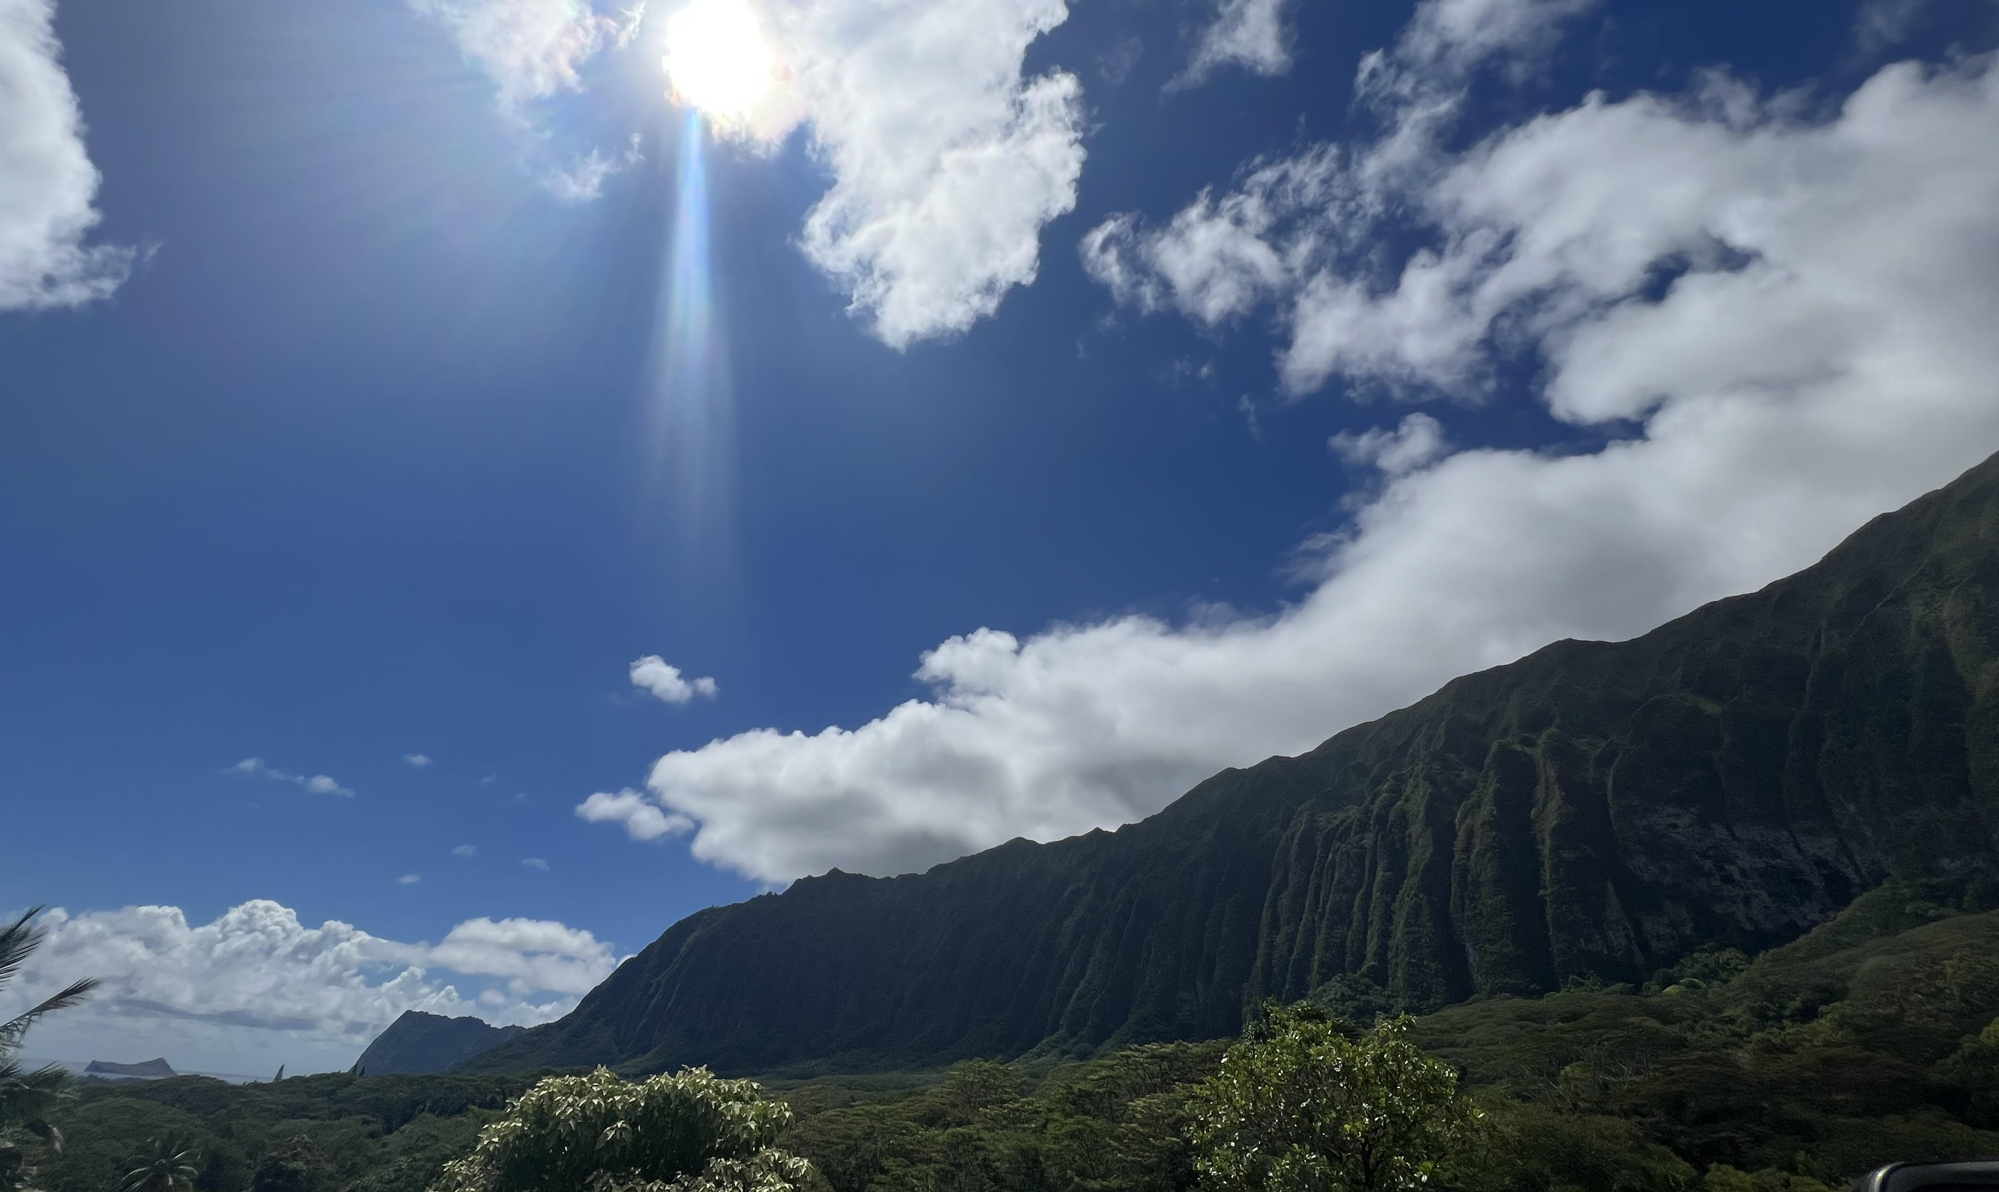
The answers are in the community.
Notes:
…And ultimately, the answers are in the community.

Slide 36
Mahalo! Arigato! Ippe Nifee Deebiru!
ACKNOWLEDGEMENTS:
Sara Becker
Emily Becker-Haimes
Rinad Beidas
Daniel Cheron
Bruce Chorpita
Sheri Daniels
Puanani Hee
Charmaine Higa-McMillan
Amanda Jensen-Doss
Bo Kim
Rachel Kim
Keawe Kaholokula
V. Kalei Kanuha
John Landsverk
Anna Lau
David Mandell
Brad Nakamura
Scott Okamoto
Ijeoma Opara
Trina Orimoto
Alayna Park
Byron Powell
Sonja Schoenwald
Halaevalu Vakalahi
Courtney Wolk
Lindsey Zimmerman
kokamura@jbcc.harvard.edu
@kelsie_okamura

