Slide 1
An Elements-Based Approach for Designing and Advancing Youth Health Service Systems
Brad Nakamura, Professor, Center for Cognitive Behavior Therapy Director, UH Manoa Dept of Psychology
Keli Acquaro, Administrator, Hawaii Child and Adolescent Mental Health Division
Ayada Bonilla, School-Based Behavioral Health State Lead, Hawaii Department of Education
David Jackson, Research and Program Operations/Evaluation Specialist, Hawaii Child and Adolescent Mental Health Division
Kimberly McDonald, School-Based Behavioral Health State Clinical Psychologist, Hawaii Department of Education
Geniel Hermandez-Armstrong, Chief Psychologist, Hawaii Child and Adolescent Mental Health Division
Puanani Hee, Data to Wisdom Clinical Data Director, Hawaii Child and Adolescent Mental Health Division
Daniel Wilkie, Co-Director, UH Manoa Center for Cognitive Behavior Therapy
Notes:
Good morning, my name is Brad Nakamura. I am a Professor in the Department of Psychology and it is my pleasure to share ”An elements-based approach for designing and advancing youth service systems.”
NOTE: 20 minutes

Slide 2
Youth mental health problems are widespread but rarely treated
Youth mental health problems are common
Epidemiological research suggests that approximately one-fourth of youth experience a mental health disorder within the past year
Youth rarely receive treatment services
Less than half of diagnosed American youth receive services
Service gap is wider for non-White youth and those with higher impairment
Asian American teens can face a range of psychological challenges
Language and cultural barriers
Pressure to fulfill “model minority” stereotypes
Microaggressions and racist encounters
APA, 2023; Kazdin, 2016; Merikangas et al., 2009; Merikangas et al., 2011; Olfson et al., 2015, Yip, 2021
Notes:
As we are all probably aware, youth mental health problems are widespread and prevalent.
However, youth rarely receive treatment and this service gap is wider for non-White and higher impaired children and adolescents.
Asian American teens can face a range of psychological challenges
https://www.apa.org/monitor/2023/07/mental-health-asian-american-teens#:~:text=Asian%20American%20teens%20face%20a,navigating%20microaggressions%20and%20racist%20encounters.

Slide 3
Massive efforts for developing and testing youth mental health treatments
Hundreds of youth mental health treatment approaches have been developed and tested
Winning treatments have become known as “evidence-based practices” (EBPs)
Chorpita & Daleiden, 2009a; Lonigan, Elbert, & Johnson, 1998; Silverman & Hinshaw, 2008; Society of Clinical Child and Adolescent Psychology and the Association for Behavioral and Cognitive Therapies, 2009; Weisz, Hawley, & Doss, 2004
Notes:
…and in response to this great youth mental health need, the field of clinical child psychology has responded spectacularly, through developing AND testing hundreds upon hundreds of youth mental health treatment approaches.
Over time, some treatment approaches have come to consistently outperform others, and these ”winning” treatments have come to be known as “evidence-based practices” or EBPs

Slide 4
Massive efforts for developing and testing youth mental health treatments
Hundreds of youth mental health treatment approaches have been developed and tested
Winning treatments have become known as “evidence-based practices” (EBPs)
Youth Problem Type | Number of EBP Programs
Anxiety | 256
Disruptive Behavior | 184
Attention/Hyperactivity | 117
Depression | 88
Trauma | 52
PracticeWise, 2024
Notes:
Collectively, there was a big boom in treatment research in the 90s and early 2000s. Take for example the four most common types of childhood mental health problems. For anxiety we can see that there are 256 brand evidence-based brand named programs or protocols for anxiety; 184 for disruptive behavior, etc.

Slide 5
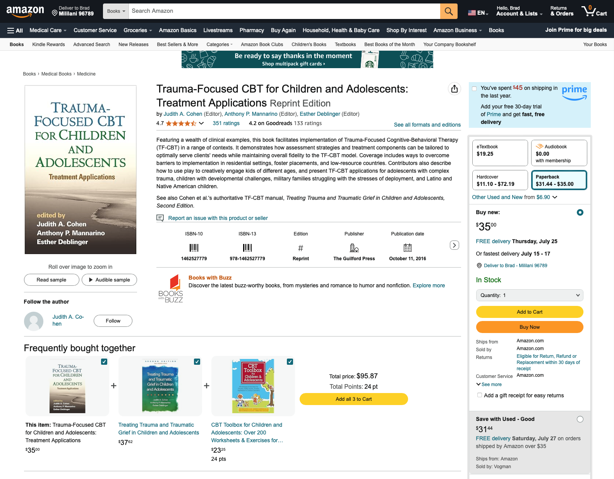
Notes:
For instance, one example of an EBP for childhood trauma is a program named Trauma-Focused CBT for Children and Adolescents. As seen here on Amazon, in addition to the option of buying the therapist manual, along with other suggestions

Slide 6
How has the availability of hundreds of EBP protocols impacted public mental health?

Slide 7
EBP Utilization Can Be Poor
Therapists receive little EBP training in graduate school
Continuing education workshops on EBP programs do not to change behaviors
Ongoing training that extend beyond workshops are lengthy and expensive
Organizational cultures and infrastructures may not support EBP utilization
Hoagwood & Olin, 2002; Riemer, Rosof-Williams, & Bickman, 2005; United States Surgeon General, 1999
Notes:
Although variable, and speaking in broad generalities, EBP utilization in public service systems can be poor.

Slide 8
Reframing ”EBP” to facilitate successful dissemination and implementation into public mental health settings
Notes:
This brings us to the crux of my talk for today: reframing what we mean by EBP can facilitate its successful uptake into public mental health settings.

Slide 9
Two complimentary EBP metrics
Brand-named treatment manuals
Practice element (or common element)
Chorpita, Becker, & Daleiden, 2007; Chorpita & Daleiden, 2009a, 2009b; Chorpita, Daleiden, & Weisz, 2005
Notes:
Let’s start first with defining the very concept of EBP or “evidence-based practice.” I will focus on two complimentary metrics for today’s talk.
NOTE: treatment family = interventions with similar theoretical underpinnings that share a majority of their clinical components. For instance, rather than score each specific cognitive behavior therapy manual for anxiety by itself,

Slide 10
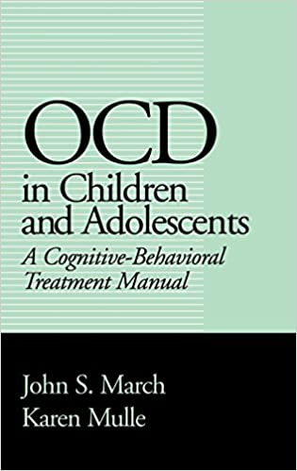
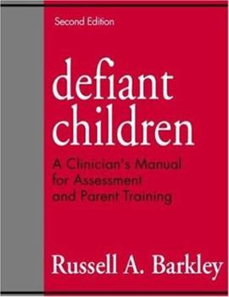
Two complimentary EBP metrics
Brand-named treatment manuals
Notes:
Remember the Coping Cat for Anxiety manual I mentioned a few slides ago, now outlined here in red, the one you can buy on Amazon? That is one of many, many different types of treatment approaches, literally hundreds upon hundreds, each with its own glossy workbook, purchase price, website, book, professional trainer, etc.

Slide 11
Two complimentary EBP metrics
Brand-named treatment manuals
Practice element (or common element): a discrete clinical technique or strategy (e.g., time out, relaxation, etc.) used as part of a larger intervention plan such as a manualized treatment program
Notes:
A complimentary approach is looking at EBPs at the practice level, the term practice element or common element refers to a discrete clinical technique or strategy (e.g., time out, relaxation, etc.) used as part of a larger intervention plan such as a manualized treatment program
Note: Chorpita, Daleiden, and Weisz (2005) note three basic assumptions of PEs including (a) practice elements can be explicitly defined (e.g., using a definition or coding manual), (b) their presence within various interventions can be reliably coded, and (c) different treatments may share practice elements in common^ (p. 11).

Slide 12
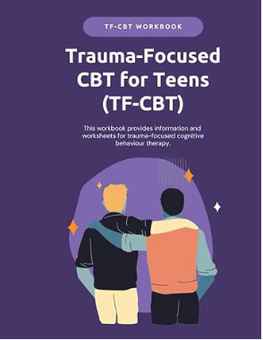
Practice Elements Approach: Trauma Example
3 brand-named protocols
Psychoeducation - C | ✓ | ✓ | ✓
Cognitive | ✓ | ✓ | ✓
Exposure | ✓ | ✓
Relaxation | ✓ |  | ✓
Narrative | ✓ |  | ✓
Psychoeducation - P | ✓ | ✓ | ✓
6 practice
elements
Notes:
For the purposes of this example, let’s say that there are only three evidence-based brand named protocols for youth trauma behaviors. We would look at these protocols side by side, and examine the frequency with which differing techniques are present in each of them.

Slide 13
Practice Elements Approach: Trauma Example
3 brand-named protocols
Psychoeducation - C | ✓ | ✓ | ✓
Cognitive | ✓ | ✓ | ✓
Exposure | ✓ | ✓
Relaxation | ✓ |  | ✓
Narrative | ✓ |  | ✓
Psychoeducation - P | ✓ | ✓ | ✓
6 practice
elements

Slide 14
Practice Elements Approach: Trauma Example
3 brand-named protocols
Psychoeducation - C | ✓ | ✓ | ✓
Cognitive | ✓ | ✓ | ✓
Exposure | ✓ | ✓
Relaxation | ✓ |  | ✓
Narrative | ✓ |  | ✓
Psychoeducation - P | ✓ | ✓ | ✓
6 practice
elements

Slide 15
Practice Elements Approach: Garlic Chicken Example
3 brand-named Garlic Chicken Recipes
Chicken | ✓ | ✓ | ✓
Flour | ✓ | ✓
Cornstarch |  |  | ✓
Shoyu | ✓ | ✓ | ✓
Sugar | ✓ | ✓ | ✓
Garlic | ✓ | ✓ | ✓
6 ingredients

Slide 16
What are commonalities across all youth trauma brand-named manuals?
Practice Element | Percent present across 52 protocols
Psychoeducation for Child | 95
Cognitive | 89
Exposure | 85
Relaxation | 70
Narrative | 58
Psychoeducation for Caregiver | 56
Maintenance / Relapse Prevention | 43
PracticeWise, 2024
Notes:
So following further our youth anxiety and coping cat example, here are the results for a 2024 analysis practice element or technique commonalities across 52 brand name protocols. As we can see here, at least for the first few practice elements, the ingredient profile if you will, is a lot more similar than they are different. For example, 95% contain the element of “Psychoeducation for Child,” and 89% contain the ingredient of “Cognitive,” and 85% contain the ingredient of “Exposure.”

Slide 17
Quality improvement initiatives rooted in the practice element metric
Notes:
Embracing the practice element metric for quality improvement has allowed for a multitude of far reaching and meaningful work

Slide 18
Quality improvement initiatives rooted in the practice element metric
Meet folks where they are; avoid all or nothing approaches to EBPs
Facilitate innovative trainings on EBP practice elements
System wide monitoring for practice element usage
Development of performance evaluations centered on practice elements
Increase precision of youth and family empowerment initiatives
Development of screeners and primary prevention efforts
Examination of literature growth for practice element changes
Nakamura et al., 2013
Notes:
I will now try to briefly touch base on seven different implications or research-based activities where we are leveraging the practice element metric for designing and improving the two largest service systems youth here in Hawaii: the departments of health and education.
Time trials up until this slide:
1. 7:04

Slide 19
Meet folks where they are; avoid all or nothing approaches to EBPs
Lahaina School-Based Behavioral Health Program, 2024
Acknowledgment of community therapists with regard to…
Sometimes community therapists are already using these practice elements
It is definitely possible to do ”evidence-based practices” without a manual
Lahaina School-Based Behavioral Health Program, 2022
Windward Oahu School-Based Behavioral Health Program, 2023
Notes:
First, embracing this common ingredient approach explicitly acknowledges to our community therapist partners several points, but most important are:
We are acknowledging their expertise and existing work in that many of them are already doing some or even a lot of these discrete components.
In this way, it is definitely possible to do “evidence-based practices” without a manual, which many EBP experts outside of our system would disagree with. In other words, it is possible to make garlic chicken without having to go to Sugoi every time

Slide 20
2. Facilitate innovative trainings on EBP practice elements
Training can happen at the practice element level (i.e., training does not need to occur for the entire protocol)
2008 to 2009: 268 DOH and DOE providers trained
EBP knowledge and attitudes improved (n = 268)
CAMHD subsample (n = 47)
Use of anxiety practice elements increased
Increases in anxiety practice element usage associated with better youth outcomes, but only in the short-term
Overall use of disruptive behavior practice elements decreased
For those therapists doing more disruptive behavior practice elements, youth improved over time
Statewide trainings focused on elements and their assembly into treatment plans
DOE statewide trainings from 2021 onward: 96+ therapists
DOH statewide trainings from 2022 onward: 74+ therapists
Lim, Nakamura, Higa-McMillan, Shimabukuro, & Slavin (2012); McLennan, Laba, Nakamura (in preparation); McLennan, Mueller, Heck, & Nakamura, 2019
Notes:
Second, training of therapists can occur at the discrete ingredient level. Most trainings do NOT occur at this discrete level and involves training full blast on maybe 12-16 ingredients at a time, thus involving large time and money commitments, and almost certainly involves flying in from the continent an expensive official trainer, from a brand-named corporation.
We’ve done research on this components-based training approach with therapists from both the departments of health and education, and we’ve found encouraging results from a statewide therapist training effort between 2008-2009. Here in Hawaii, we found that a components-based training was associated with:
Increased knowledge about EBPs
Betterment of attitudes about EBPs
Increased usage of key practice practice elements for anxiety problems
Better youth outcomes in the short term for anxiety problems and longer term for disruptive behavior problems

Slide 21
3. System wide monitoring for practice element usage
Electronic Health Record / Practice Management Systems
CAMHD launched MAX in February 2019
Therapists document on a session-by-session basis for each youth they serve
Treatment targets: anxiety, trauma, depression, inattention, disruptive behavior, etc.
Practice elements: exposure, psychoeducation for child, relaxation, narrative, etc.
CAMHD’s management information system produces feedback reports for quality improvement planning
Notes:
Focusing on discrete ingredients have also allowed for system-wide practice monitoring. In other words, looking at every single therapists’ approach for every one of their patients. Built into an electronic health recording system, therapists can indicate which practice elements they are using for which patients. Knowing which practices are being done out in the community allows us to pinpoint with precision where our therapist training campaigns should focus, and the effect of those therapist training campaigns.
Embracing the practice element metric allows us to ask questions like: for kids with anxiety disorders within CAMHD, how many of them receive one or more treatment sessions focused on the ingredient of exposure?

Slide 22
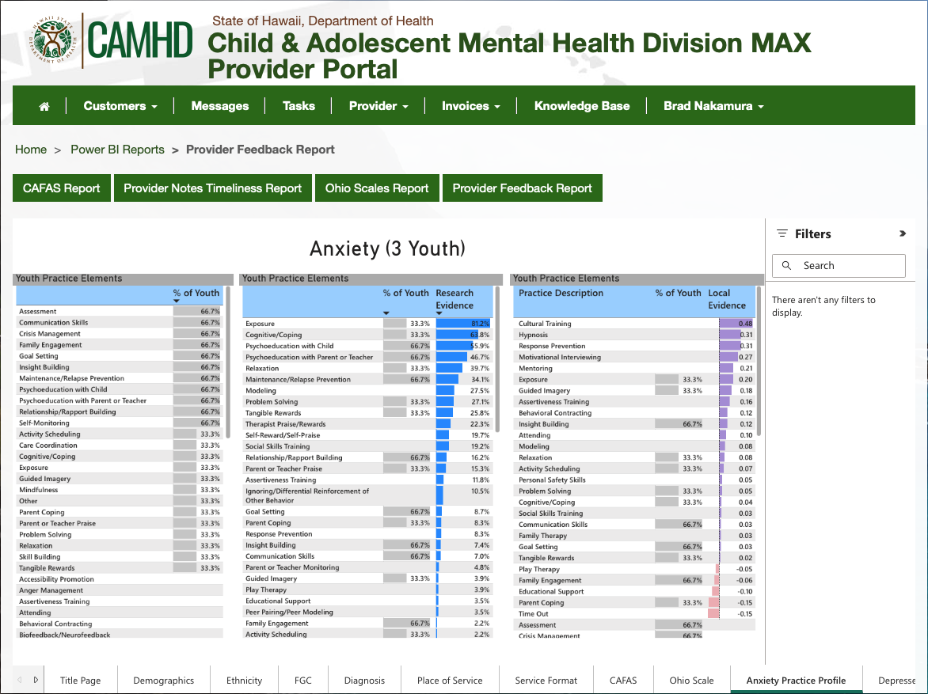
Notes:
For example, at our treatment clinic within the department of psychology, we have provided treatment services for three youth with anxiety problems over the last year. As a supervisor, when I log into the CAMHD MAX provider portal, I can access many reports, of which we are seeing just one.

Slide 24
Notes:
What are the practice patterns that emerge for anxious youth at our treatment center?

Slide 25
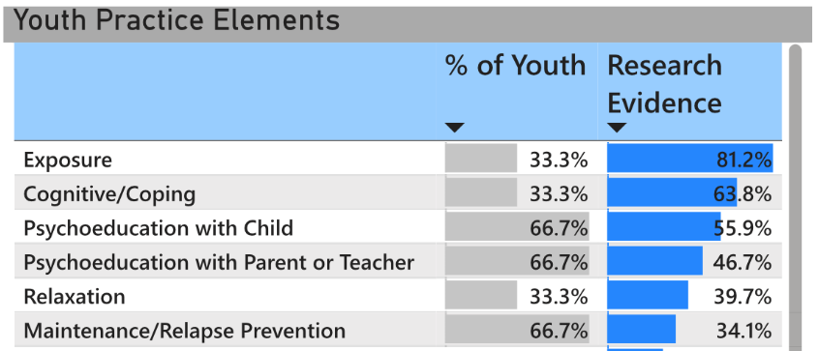
Notes:
What are the practice patterns that emerge for anxious youth at our treatment center?

Slide 26
Notes:
What are the practice patterns that emerge for anxious youth at our treatment center?

Slide 27
3. System wide monitoring for practice element usage
Electronic Health Record / Practice Management Systems
CAMHD launched MAX in February 2019
Therapists document on a session-by-session basis for each youth they serve
Treatment targets: anxiety, trauma, depression, inattention, disruptive behavior, etc.
Practice elements: exposure, psychoeducation for child, relaxation, narrative, etc.
CAMHD’s management information system produces feedback reports for quality improvement planning
Notes:
Focusing on discrete ingredients have also allowed for system-wide practice monitoring. In other words, looking at every single therapists’ approach for every one of their patients. Built into an electronic health recording system, therapists can indicate which practice elements they are using for which patients. Knowing which practices are being done out in the community allows us to pinpoint with precision where our therapist training campaigns should focus, and the effect of those therapist training campaigns.
Embracing the practice element metric allows us to ask questions like: for kids with anxiety disorders within CAMHD, how many of them receive one or more treatment sessions focused on the ingredient of exposure?

Slide 28
3. System wide monitoring for practice element usage
Electronic Health Record / Practice Management Systems
CAMHD launched MAX in February 2019
Therapists document on a session-by-session basis for each youth they serve
Treatment targets: anxiety, trauma, depression, inattention, disruptive behavior, etc.
Practice elements: exposure, psychoeducation for child, relaxation, narrative, etc.
CAMHD’s management information system produces feedback reports for quality improvement planning
The DOE School-Based Behavioral Health Program launched Lokahi in January 2023
Therapists document on a session-by-session basis for each youth they serve
Treatment targets: anxiety, trauma, depression, inattention, disruptive behavior, etc.
Practice elements: exposure, psychoeducation for child, relaxation, narrative, etc.
We are beginning to provide feedback reports to various districts and counties (e.g., Lahaina)

Slide 29
4. Development of performance evaluations centered on practice elements
Role-play tests for two major practice elements
Exposure
Problem-Solving
Written tests for six major practice elements
Exposure
Problem-Solving
Activity Selection
Communication Skills
Psychoeducation for Caregiver
Maintenance / Relapse Prevention
Higa-McMillan et al., 2017; Higa-McMillan et al., 2020; Maesaka et al. (under review); Nakamura et al., 2014
Notes:
Fourth, and also related to training, either continuing education for already licensed therapists; or for pre-service training for students in graduate school, our lab has developed both role-play and written evaluations for demonstrating procedural knowledge for a variety of key EBP ingredients. We have been able to code both written and role-play behaviors reliably, at both pre- and post training experiences. Based on our research here, there is great promise for developing competency assessments at the ingredient level.

Slide 30
5. Increase precision of youth and family empowerment initiatives
https://www.helpyourkeiki.com
Help Your Keiki (HYK) is a parent-centric website, developed for parents, by parents in collaboration with community and university-based experts focused on sharing with parents EBP information centered on the EBP metric
We are the ONLY parent-centric website sharing practice element information
An official partner website for the major website on youth mental health practices
American Psychological Association’s https://effectivechildtherapy.org
Friedberg et al., 2020; Nakamura et al., 2013
Notes:
Fifth, we have partnered with both CAMHD and DOE for developing a parent-centered website on EBPs. Now 9 years old, the Help Your Keiki website aims to empower parents and families with information on youth mental health EBPs at the practice element level. We are the only website in existence that intersects: being aimed squarely at parents with practice element information. We are an official partner website of the American Psychological Association.

Slide 31
6. Development of screeners and primary prevention efforts
Development of youth questionnaires for practice element skill usage
Social-Emotional Evidence-Based Developmental Strengths (SEEDS) survey: questionnaire that asks youth about how much they use 13 practices (e.g., exposure) in their daily lives.
Youth self-report (N = 402)
Factor structure
Reliability
Convergent validity
Parent-report of children’s behaviors
Matsui & Nakamura (in preparation)
Notes:
A sixth quality improvement effort uniquely afforded by the practice element metric involves developing questionnaires for youth about how much they use these practice elements in their daily lives. Aptly named the Social-Emotional Evidence-Based Developmental Strengths (SEEDS) we recently tested this questionnaire with 400 fourth through sixth graders and found support for its factor structure of assessing 13 practice elements, like relaxation and exposure. We also found evidence for its reliability and convergent validity. We are now in the process of expanding our study to a parent report-questionnaire. Our SEEDS-based efforts are exciting because it intersects the ideas of practice elements ,youth strengths (rather than deficits) and large scale prevention and screening work.

Slide 32
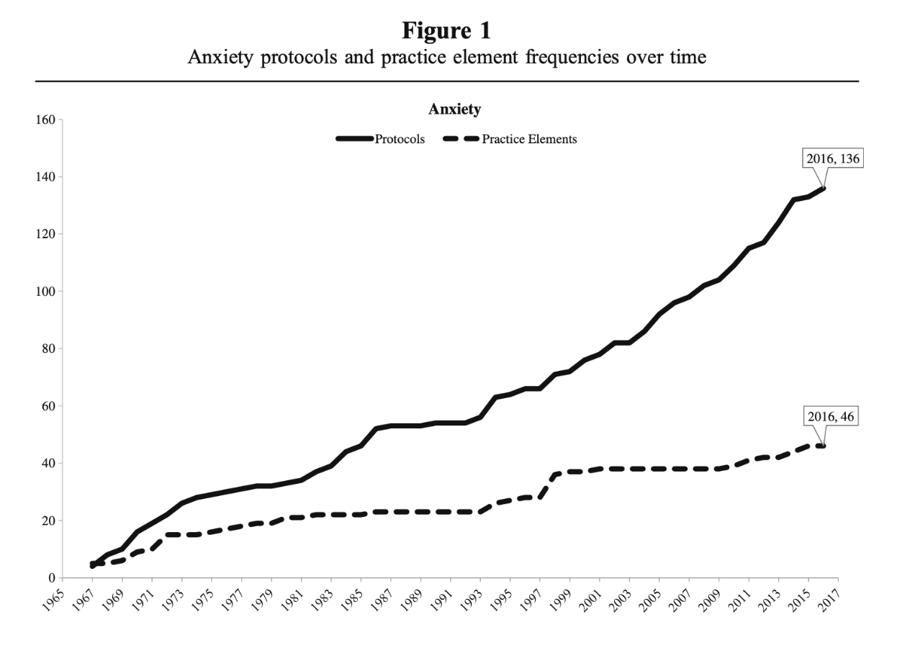
7. Examination of literature growth for practice element changes
Okamura, Orimoto, Nakamura, Chang, Chorpita, & Beidas (2019)
Notes:
Finally, practice element methodology has allowed for more fine grained examination of the literature on studying youth EBPs. Here is a figure charting over time in years for youth anxiety (a) the number of brand name manuals (solid line) and (b) the number of (practice elements) associated with those manuals.

Slide 33
7. Examination of literature growth for practice element changes
Okamura, Orimoto, Nakamura, Chang, Chorpita, & Beidas (2019)
Notes:
Between 1967 to 2016…

Slide 34
7. Examination of literature growth for practice element changes
136 protocols
46 elements
Okamura, Orimoto, Nakamura, Chang, Chorpita, & Beidas (2019)
Notes:
We found that since 1997, there has been a flattening of identifying new practice practice elements (dashed lower line), while there continues to be a large growth of the packaging of these elements into brand named approaches (solid upper line)

Slide 35
Conclusion
An elements-based approach for service system design and improvement can help improve public mental health
Community-university partnerships are essential for for large scale quality improvement initiatives
Contact information
Brad Nakamura, Ph.D.
Professor, UH Manoa Dept of Psychology
bradn@hawaii.edu
Notes:
An elements-based approach for service system design and improvement can help improve public mental health. Our department of psychology is blessed for its partnerships with the departments of health and education, and will continue these and several other types of these efforts. Thank you for your time!

