Slide 1
I invite you to take a moment, to close your eyes.

Slide 2
Notes:
Trina:
Why and how was this survey conducted?
What are a few examples of the data capabilities that might inspire potential uses?
How will the findings be used for decision making and action?
Really, this presentation is an invitation to you dig into, get curious about, and use some interesting data from the community.

Slide 3
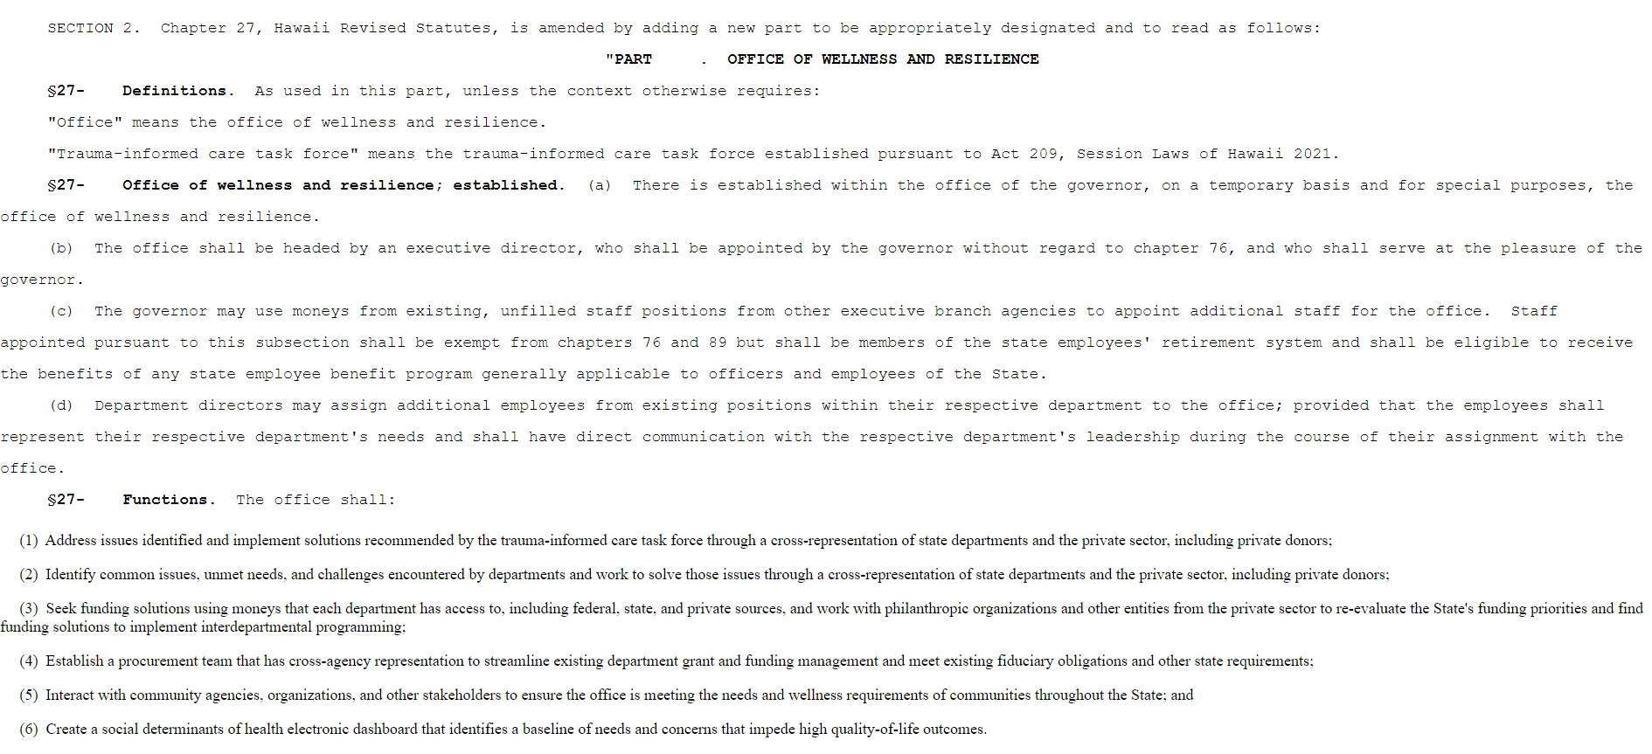
Notes:
In 2022, the community driven trauma informed care task force recommended the creation of the OWR
When the office was created, the TIC task force wisely identified a number of core deliverables, towards the goal of making the state more trauma informed. One of those was..

Slide 4
(6) Create a social determinants of health electronic dashboard that identifies a baseline of needs and concerns that impede high quality-of-life outcomes.
Notes:
Kev:

Slide 5
Principles of Trauma-Informed Care
Notes:
Kev:
Creating the SDOH dashboard is very much in line with the majority if not all of the principles of TIC. As the dashboard would be transparent, involve data for shared decision making,

Slide 6
OWR’s Tasks & Efforts
Trauma-Informed Policies, Programs & Practice
Training & Technical Assistance
Data & Assessment
Partnership & Collaboration
Notes:
Kev:
This effort also aligns closely with OWRs key tasks and efforts

Slide 7
Our Team
Notes:
Kev:
In order to do this work, OWR reached out to Jack Barile and brought on his team as partners in this endeavor.

Slide 8
Social Determinants of Health – What are the conditions in which we grow, work, live and age?
Notes:
Trina:
Now we all know that at core, the conditions in which we grow, work, live and age that affect a wide range of health, functioning, and quality-of-life outcomes and risks. They are also related to health disparities and inequities. So much so, that we know that your zip code is a stronger predictor of your likely health outcomes. We also know that there is much work to be done to improve the upstream systemic drivers of health.

Slide 9
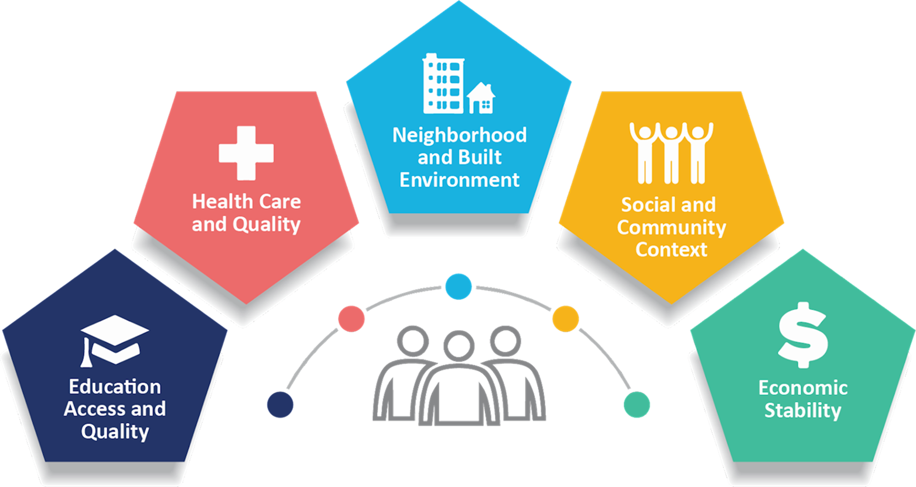
The Hawaiʻi Quality of Life Survey
A large, statewide survey of quality of life in Hawaiʻi adults to:
Evaluate the status of quality of life in and across neighborhoods, regions, and subpopulations;
Identify strengths, challenges, and potential interventions across domains; and
Evaluate the effectiveness of those actions for individual and system-level outcomes.
Notes:
Trina:
Which is why our team set out to conduct two, primary data collection surveys. While we know that there are numerous other data sources that exist, we saw this as a shared opportunity to flexibly ask a variety of questions focused on QOL topics, responsive to the present day needs.

Slide 10
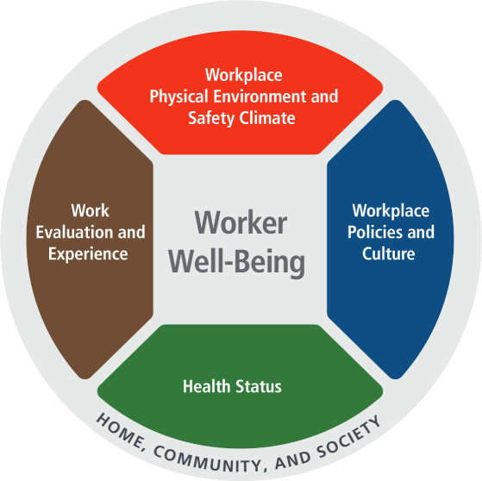
The Hawaiʻi Workplace Wellness & Quality of Life Survey
A large, statewide survey of quality of life and workplace wellness in state government workers to:
Examine the status of worker well-being domains for state agencies;
Inform strategies to uplift areas of strength and opportunity; and
Begin to examine changes over time to worker well-being to assess the impact of strategies and changes to policies and programs.
Notes:
Kev:
Given the focus of the OWR, we also conducted an additional and simultaneous survey focused on state workers with the goals of x

Slide 11
Disaster preparedness
Worker well-being
Physical & mental health
Health care access
Adverse childhood experiences
Family & community support
Educational Opportunities
Food security
Housing
Identifying Challenges and Solutions
Notes:
Trina:
While there were some subtle differences between the surveys, we ask about domains that are critical to understanding QOL and workplace wellness in Hi. For example, we query folx about health care access, disaster preparedness, food security, and housing

Slide 12
How was the survey disseminated?
State Workers
(N~4700)
Dates: 2/21/24 – 5/31/24
Survey Company (N~2600)
Dates:
1/26/24 – 5/31/24
Community Members
(N~1000)
Dates: 2/21/24 – 5/31/24
Notes:
Trina:
To get statewide participation, the online survey link was distributed broadly through 3 different mechanisms.
And lastly to specifically target state workers,

Slide 13
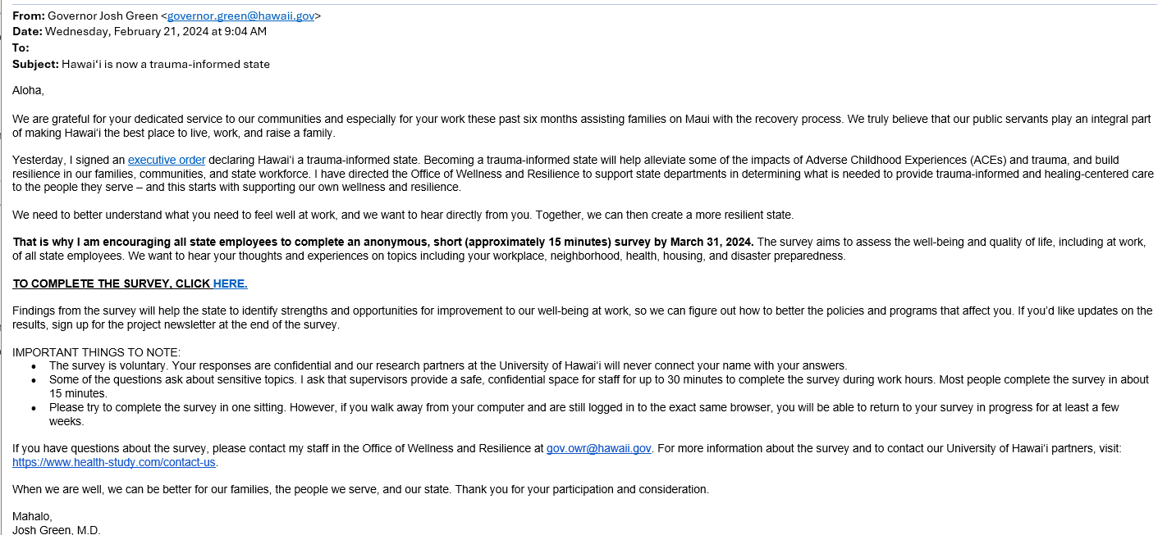
Notes:
Trina:

Slide 14
How was the survey disseminated?
State Workers
(N~4700)
Dates: 2/21/24 – 5/31/24
Survey Company (N~2600)
Dates:
1/26/24 – 5/31/24
Community Members
(N~1000)
Dates: 2/21/24 – 5/31/24
Notes:
Trina:
Second, through a contracted survey company and their survey panels.
Third, through community contacts and a media campaign

Slide 15
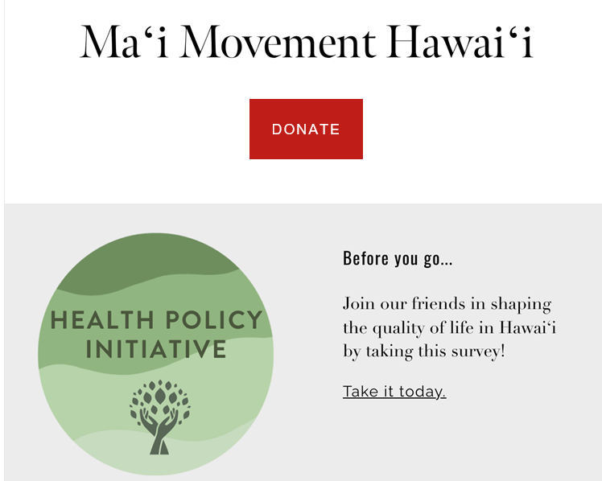
Notes:
Trina:
And we are so grateful for the community effort. The team sent over 760 emails, many of which were linked to additional list servs. And super gracious folx included the survey call in their newsletters and social media posts.
Stduents in CSS also helped to create a promo video starring
760 emails+

Slide 16
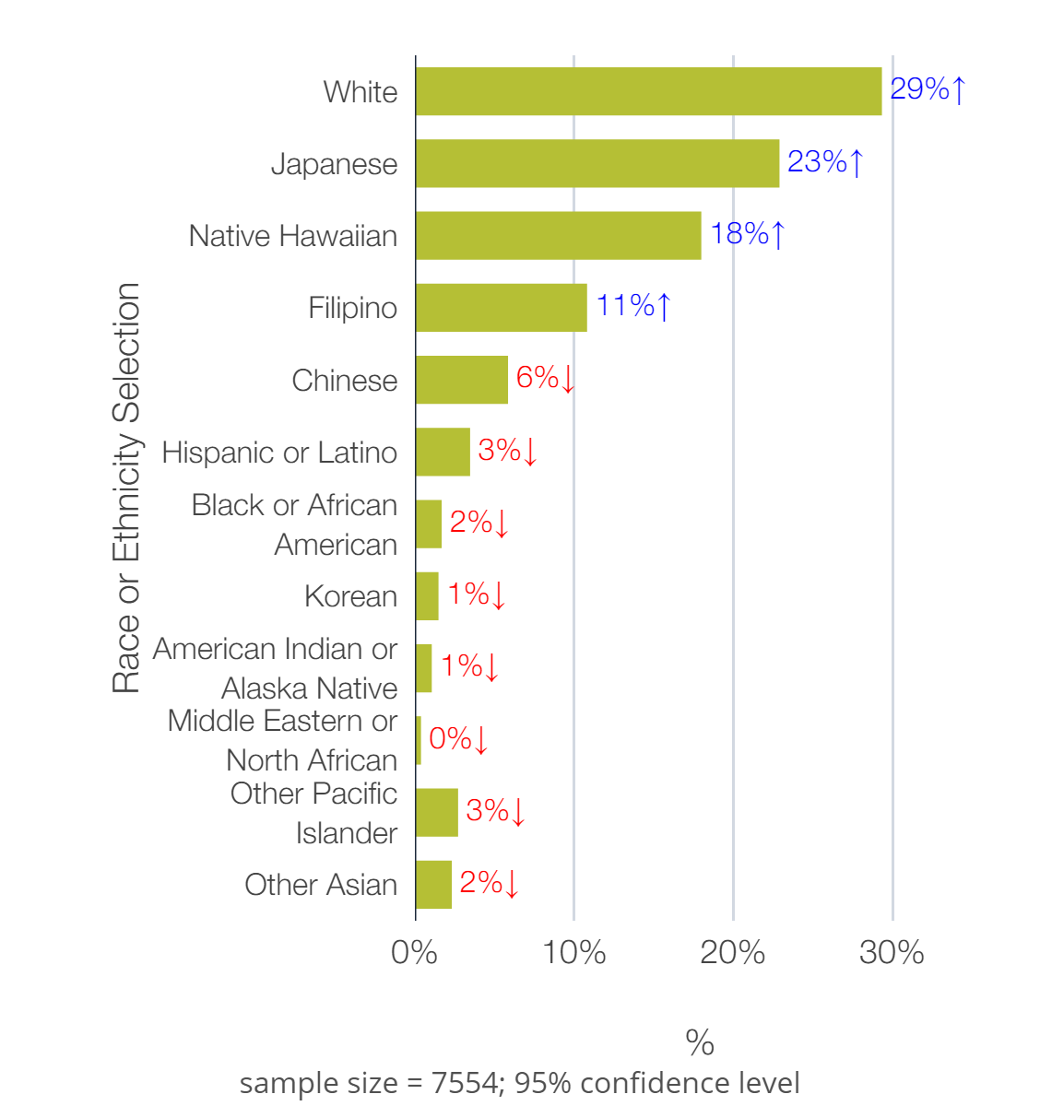
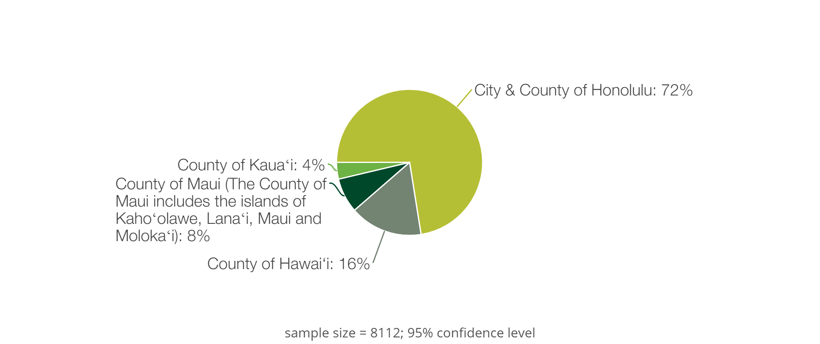
Participant Demographics (~N=8300)
64% Female, Average age 47 years
Largest wellness survey in the state
Largest administration of the WellBQ in the nation to date
Notes:
Trina:
General respondent demographics:
-higher female (typical for self report surveys)
-avg age slightly higher than the HI median (40)
-compared to state population – relatively comparable participation by county
-community and state respondents different slightly on primary race/ethnicity

Slide 18
In these examples, I invite you to imagine the ways in which data like this might be useful to you and/or your partners…

Slide 19
Disaster preparedness
Worker well-being
Physical & mental health
Health care access
Adverse childhood experiences
Family & community support
Educational Opportunities
Food security
Housing
Identifying Challenges and Solutions
Notes:
Trina:

Slide 20
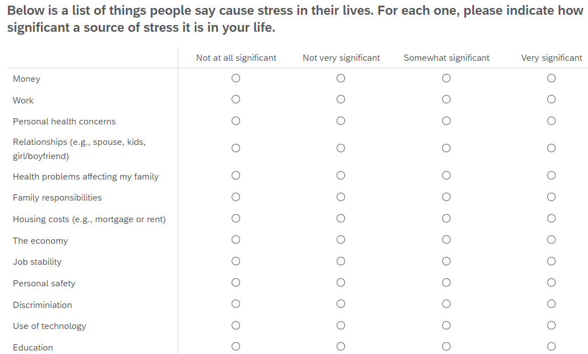
How significant a source of stress are each of the following in your life:
Notes:
Trina
Utilizing a measures from APA’s stress in America survey, we also asked all respondents how significant each of these potential stressors was in their lives.

Slide 21
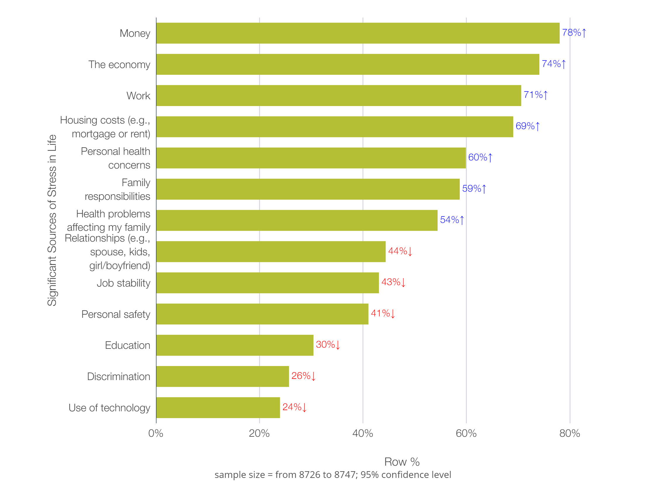
Community + State Worker
Sample Total

Slide 22
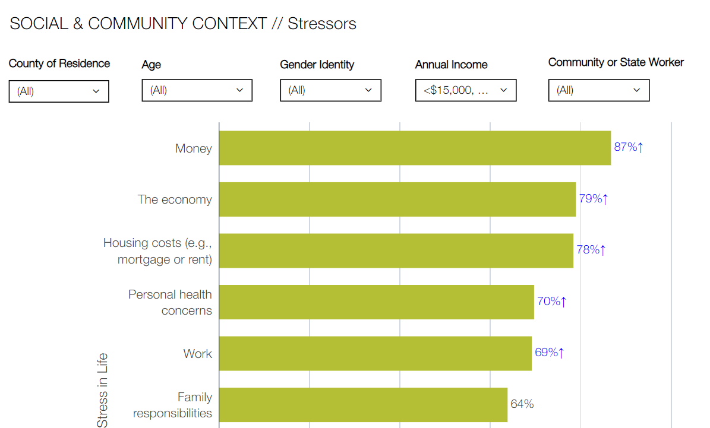
Notes:
Compared to what?
Alpha version of the dashboard allows for filtering on various demographic factors
If we focus for example on income, and examine individuals with average annual income less than 35k,
Youll notice that the significance of the stressors, increases, and the order of some of the stressors changes.

Slide 23
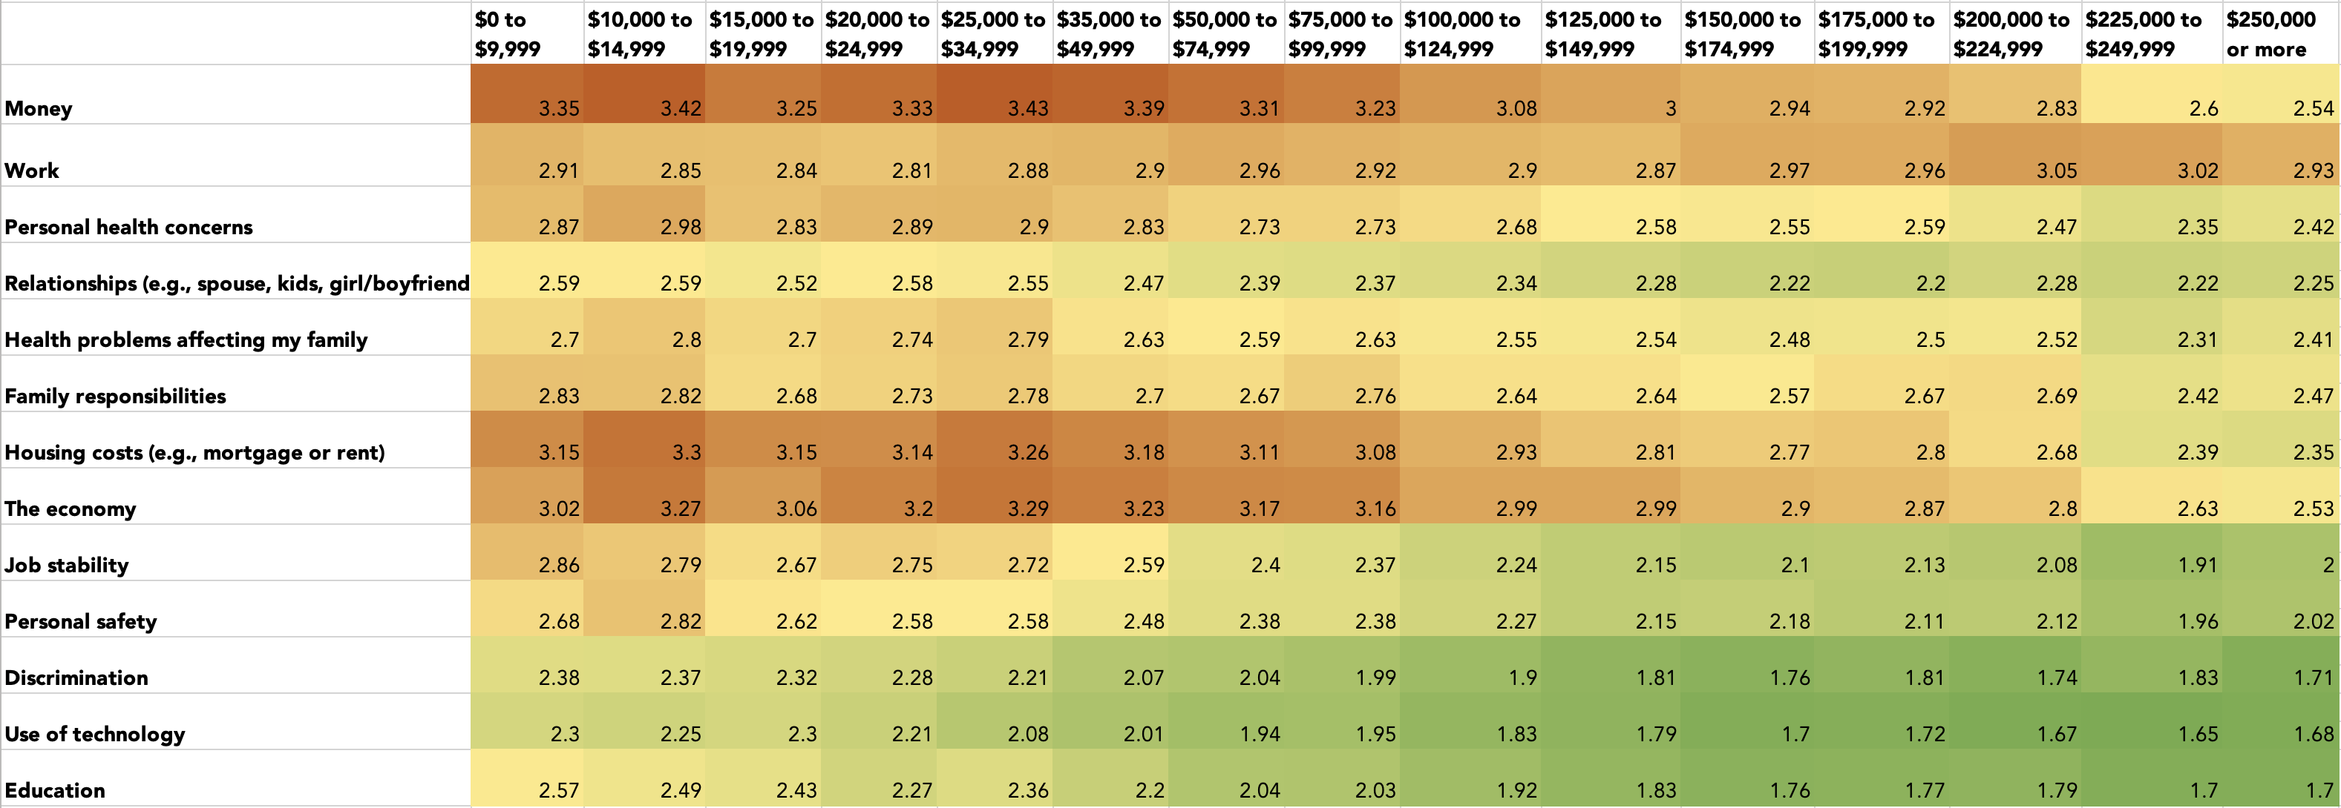
Stressors
Annual Household Income
In general, lower annual household income is associated with
higher average ratings of stress across most domains (except work)
Notes:
We can dig into this further, and look at mean stress scores by income. You’ll notice that annual household income increases from left to right. And red = higher stress scores.
Not surprisingly, individuals with lower annual household income (the left columns) have higher stress scores (red) across more domains than those with higher income.

Slide 24
Disaster preparedness
Worker well-being
Physical & mental health
Health care access
Adverse childhood experiences
Family & community support
Educational Opportunities
Food security
Housing
Identifying Challenges and Solutions
Notes:
With this data,

Slide 25
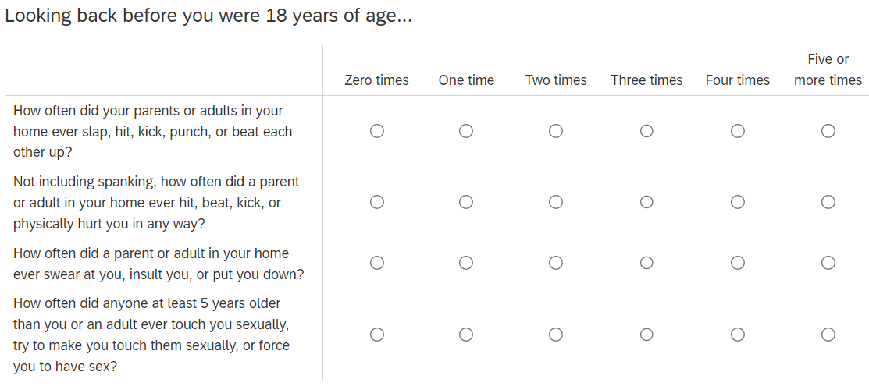

Slide 26
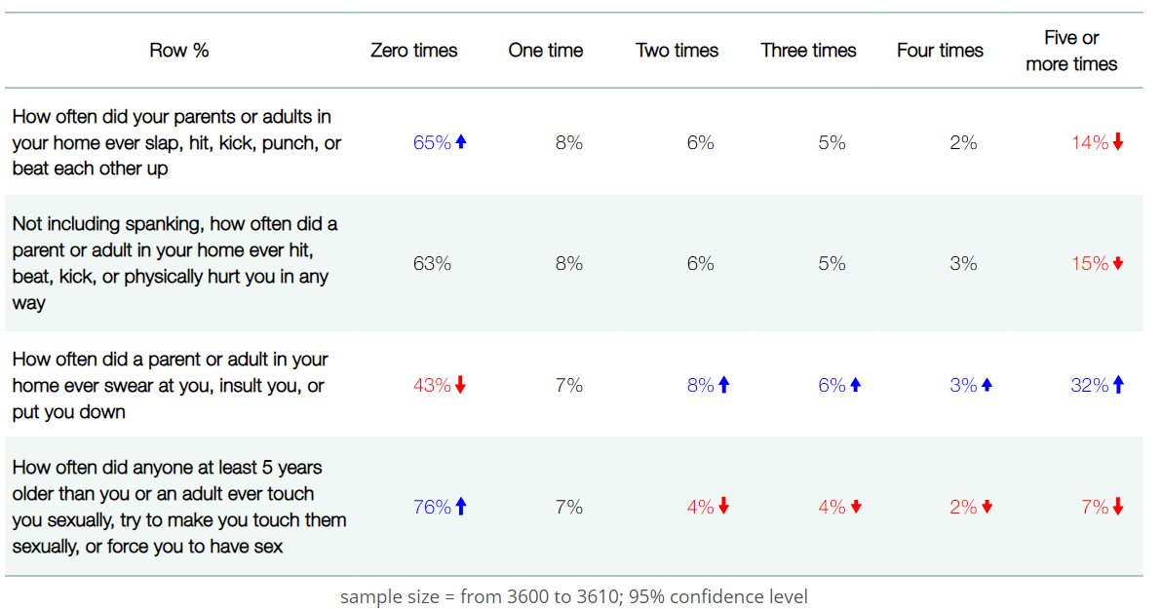
Community Sample Total
Notes:
65% = 2022 BRFSS
57% v 34 %

Slide 27
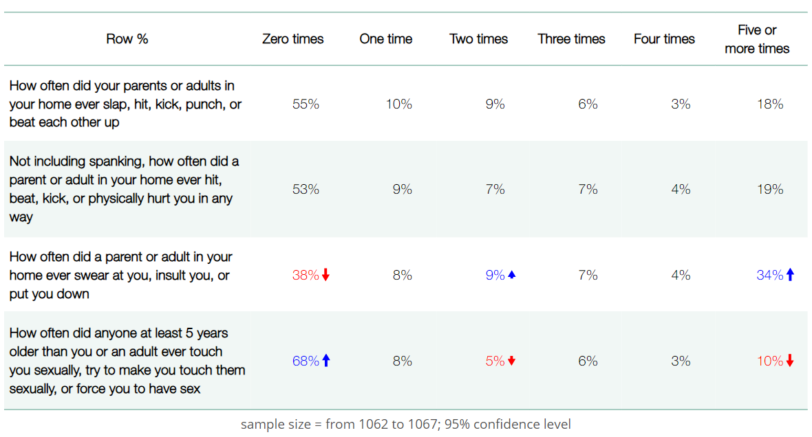
Community Sample Total
Annual Income <$35k
Notes:
65% = 2022 BRFSS

Slide 28
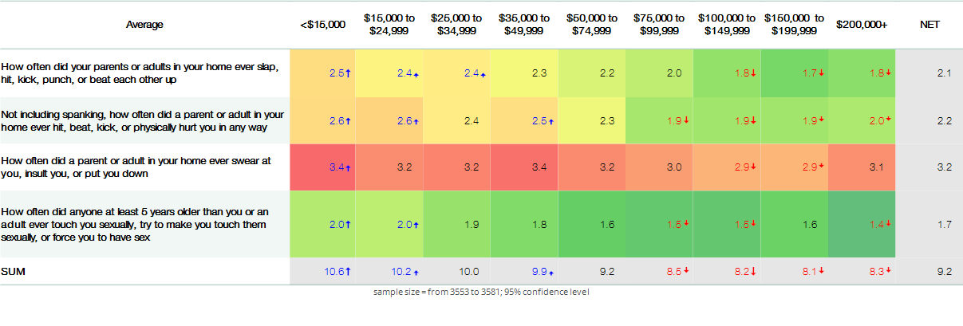
In general, lower annual household income is associated with self-reported ACEs

Slide 29
Disaster preparedness
Worker well-being
Physical & mental health
Health care access
Adverse childhood experiences
Family & community support
Educational Opportunities
Food security
Housing
Identifying Challenges and Solutions
Notes:
Trina:

Slide 30
Supportive work culture
Health culture at work
Benefits
Organization of work and life
Notes:
Trina:
The majority of questions on worker well being were from the CDC’s Worker WellBQ.
This is the LARGEST administration of the WellBQ to date
Questions were derived from the idea that 4 domains, including policies and culture, contribute to overall wellbeing

Slide 31
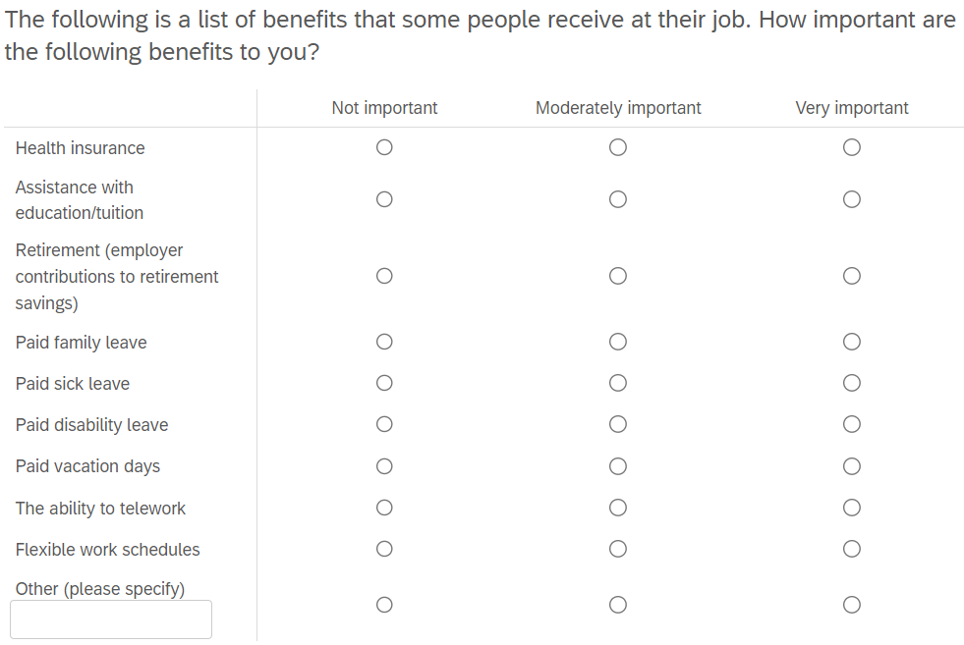
How important are the following employment benefits to you:
Notes:
And as another example that is extremely relevant to understanding worker wellbeing, we ask about the relative importance of different types of employment benefits.

Slide 32
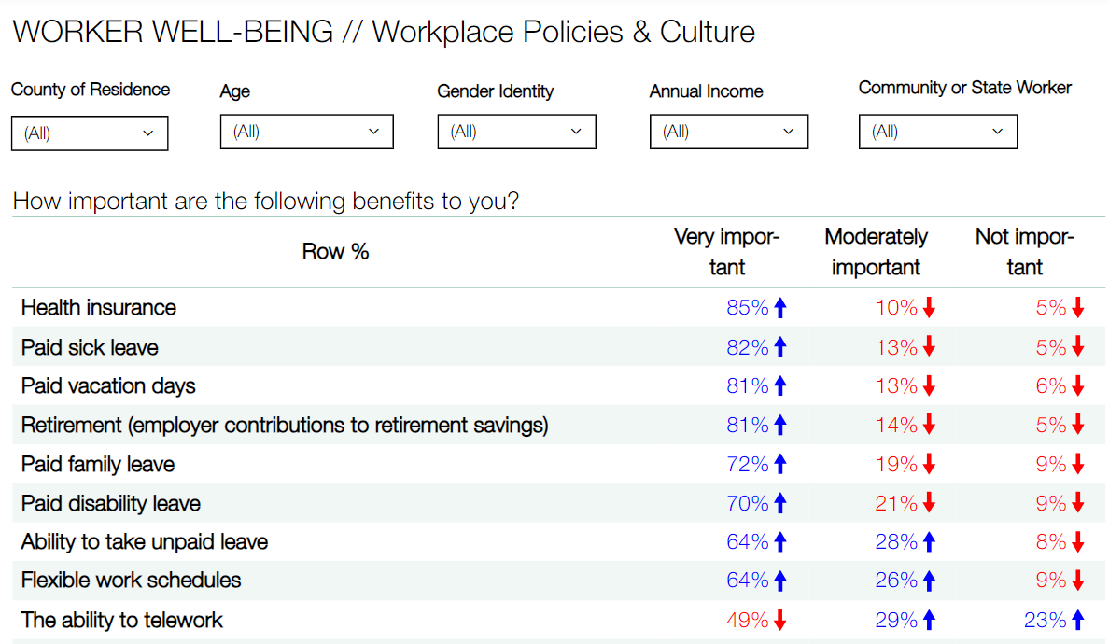

Slide 33
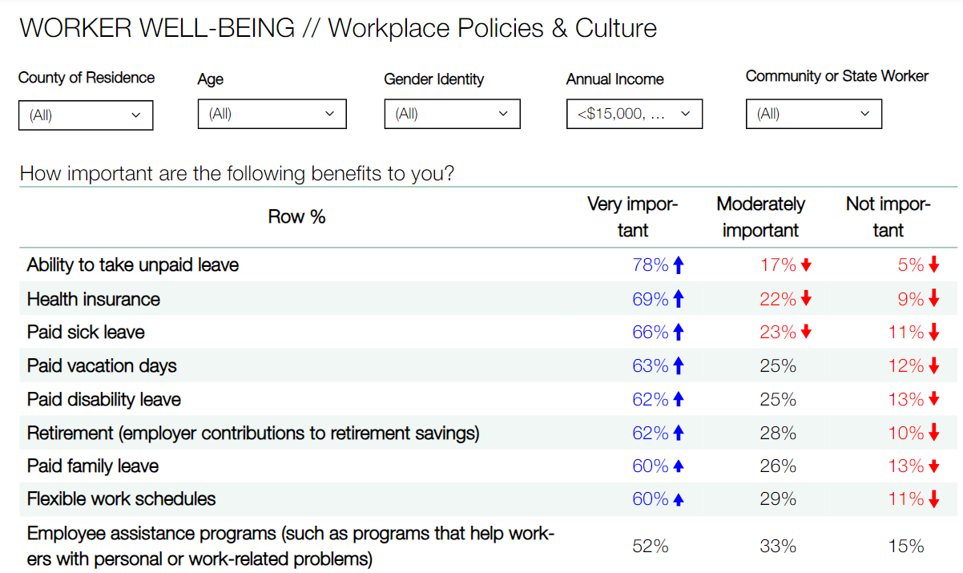

Slide 34
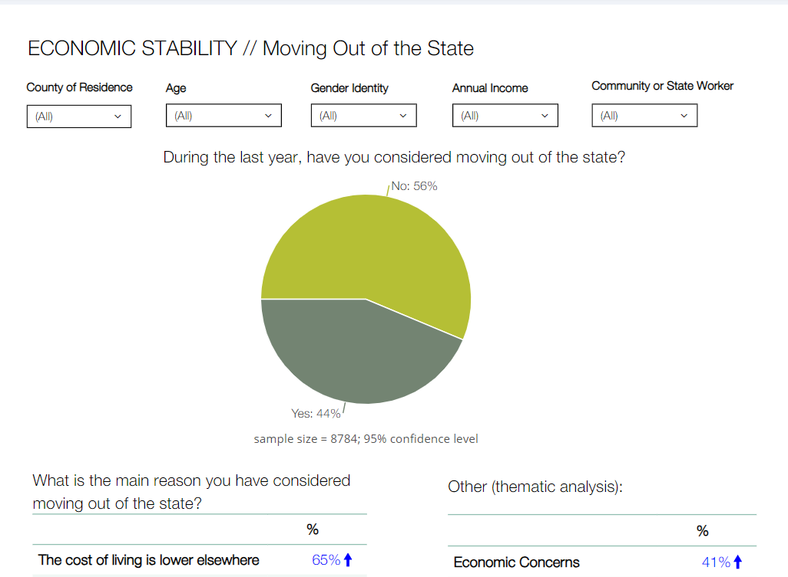
How might we use these data tools for shared action and impact?
Reports and dashboards for use by community members, policymakers, advocates, state agencies, providers, foundations, researchers, etc.
Notes:
Trina:
Our shared plan to develop reports and dashboards, so this larger, aggregated community data can be viewable by other demographic features.
This is the type of information that be used, for example, to inform policy. Or to incorporate in grant writing. As an example, a few days ago, I was reviewing requirements for a SAMHSA grant, which now requires all applicants to incorporate a behavioral health disparities impact statement, with community data on social determinants of health that need to be tracked over time.

Slide 35
How might we use these data tools for shared action and impact?
Learning collaboratives for state agencies (coming soon)
Trauma-informed care trainings and technical assistance
Trauma-informed care capacity building
Policy development
Notes:
Kev:
We don’t want this data to sit on a shelf and we want it to be able to inform the collaborative work we will do together to make our state more trauma informed
Which is why in the near future, OWR will be launching with many of our state entity partners workplace wellness planning and learning collaboratives including TA, training, capacity building, and data review support.
This capacity development ensures that we are collaboratively and humbly partnering together to finding practical and actionable ways to improve how we support staff and clients.
As an example, agencies participating in these learning collaboratives might get their own data reports so that they can accurately see their areas of strength and improvement, and OWR can provide targeted TA and training as requested.

Slide 36
What if…
Increase accessibility in future iterations?
Language access
Individuals with I/DD
Targeted sampling
Include or adjust items to better meet community needs?
Creatively filter data while maintaining privacy for respondents?
Celebrate outcomes over time?
Notes:
Kev:

Slide 37
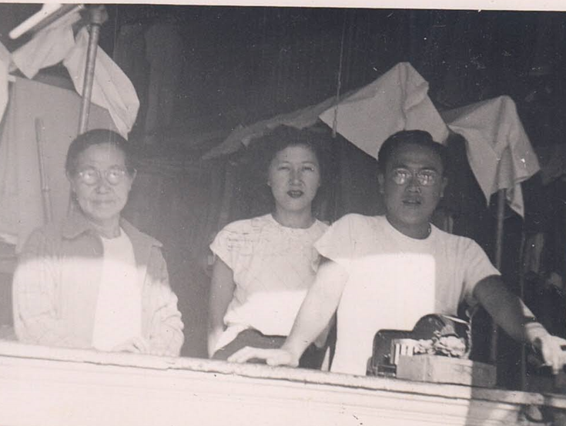
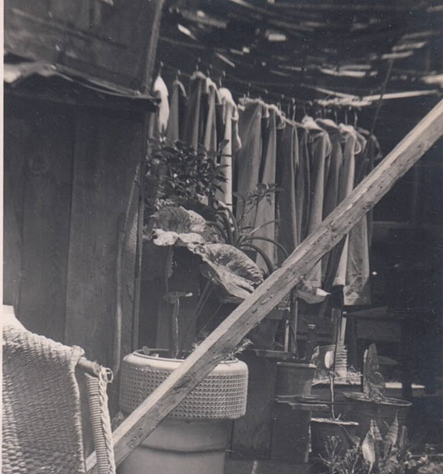

Slide 38
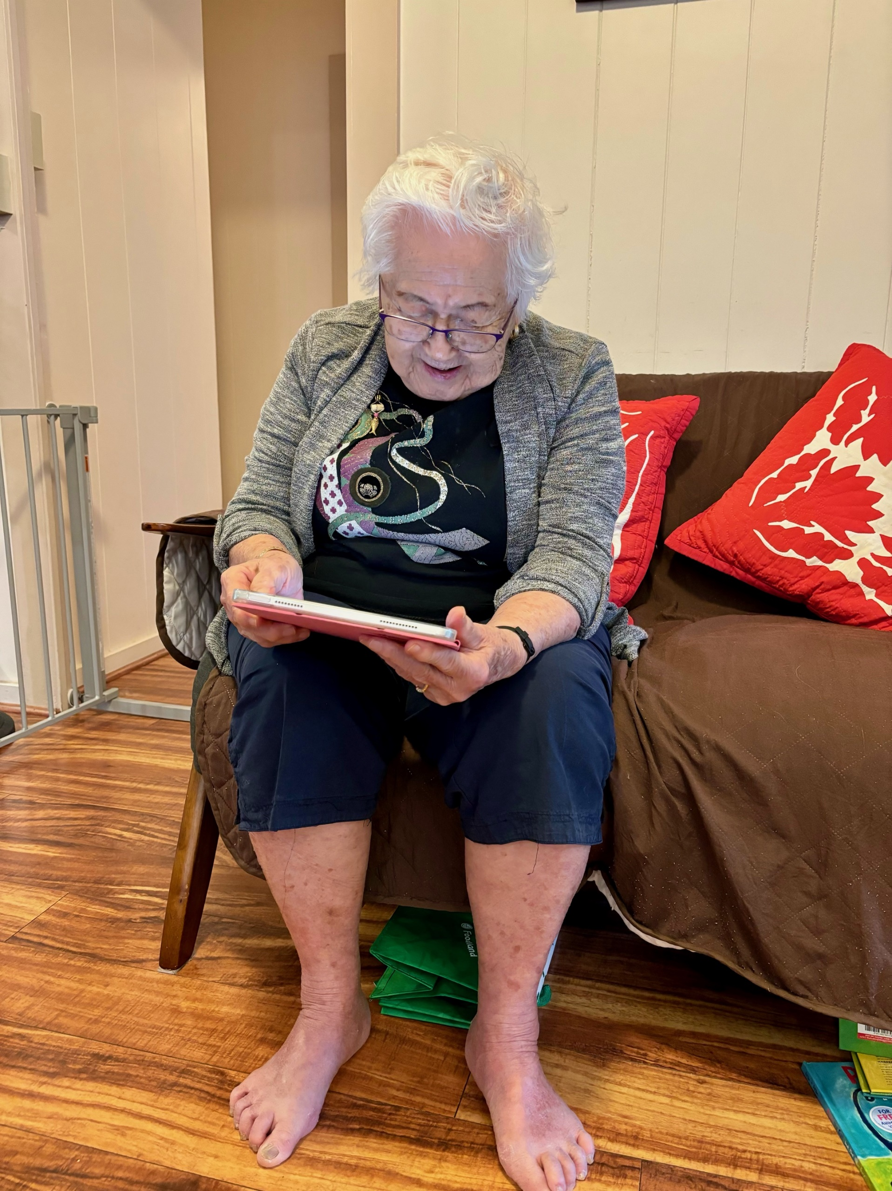

Slide 39
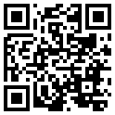
barile@hawaii.edu || gov.owr@hawaii.gov || trinao@hawaii.edu
University of Hawai‘i, Health Policy Initiative
John (Jack) P. Barile, PhD
Trina E. Orimoto, PhD
Holly R. Turner, MA
Sasha Helfner, MA
Caleb Rivera, MA
Salena Diaz, MA
Jaeho Kook, MA
Si Woo Chae, MA
Lorie Okada, BA
Office of Wellness and Resilience, Office of the Governor,
State of Hawai‘i
Tia L.R. Hartsock MSW, MSCJA
Kevin Thompson, PhD, MSW
Erica Yamauchi, MAMC
Keala Kaʻōpūiki-Santos, BEd
Naomi Leipold, MA
Jodie L.H. Burgess, BA
health-study.com
Notes:
Trina:
at core, this project was born out of a desire to make our home a trauma informed state and to improve our shared quality of life
We want to mahalo the office of wellness and resilience for trusting us as their partner and we are excited to share results with you all soon! We are also always looking for partners, so please reach out to connect with us on email, social, or thru our coming newsletter.
Thank you!

